Slide 1


Your Societies
Where Science Meets Community
Presented by
Your Name
Your Job Title, Etc
Today’s Date
Notes:
Presenter: briefly introduce yourself.
Hi, I'm <name>. I am a <job title> at <company/org>, and I've been a member of <society names> for <number of years>.
I'd like to learn a little bit about all of you.
Who comes from an agricultural background?
Is anyone already a member of our societies?
Has anyone attended our Annual Meeting?

Slide 2
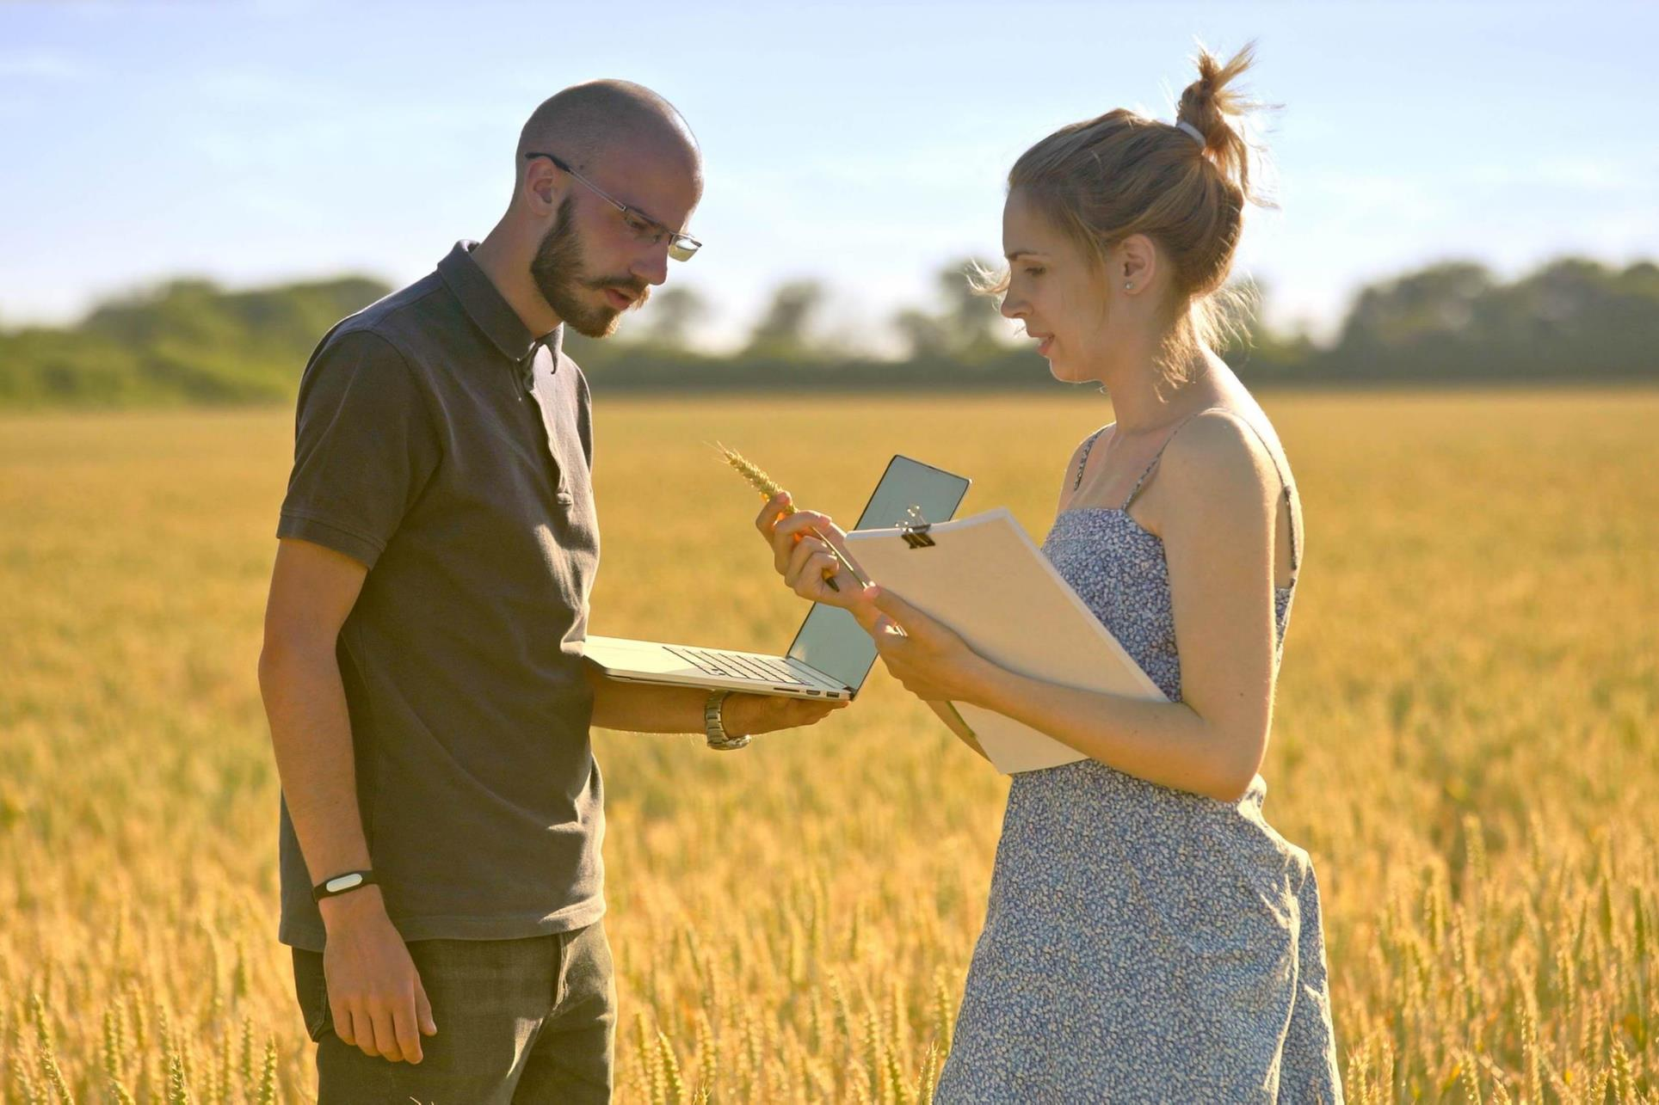

What’s your passion?
Why did you choose your field of study?
Notes:
Presenter notes: Let me begin by asking you some questions.​
What are you MOST passionate about?​
Raise your hand if you’re passionate about human health?​
Who is passionate about the environment?​
Who’s passionate about food, or maybe wine?​
Who’s passionate about science and human discovery?​
I’m here today to talk with you about how you can put those and other passions to work every day through a career in soil science, or perhaps in the related disciplines of agronomy or crop science.​
I’m going to share some stories about scientists who have made impacts on the world – in magnificent ways.​
I’m going to tell you my own story, why I chose a career in soil science, and why – if I had to do it all over again – why I’d choose the exact same career.​
And I’m also going to talk with you about the Soil Science Society of America. I sit on the board of directors of that organization. I want to tell you about the great work we’re doing and how engagement as a member of SSSA and our sibling organizations – the Crop Science Society of America and the American Society of Agronomy – is something you should consider if you, indeed, are interested in soil science … or crop science or agronomy.​

Slide 3

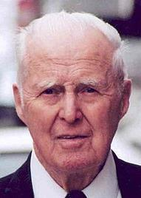
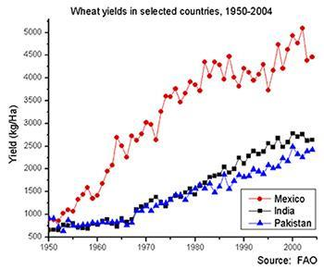
Faces of Our Field
Norman Borlaug
Agronomist
1914 - 2009
Notes:
You may already know part of the story of Norman Borlaug, likely the most famous and influential agronomist of the modern era. It was thanks to his work, and the work of others like him—in fertilizer use, high-yield strains, pesticide, irrigation and more—that our planet’s farmers can feed a population of more than 8 billion.

Slide 4
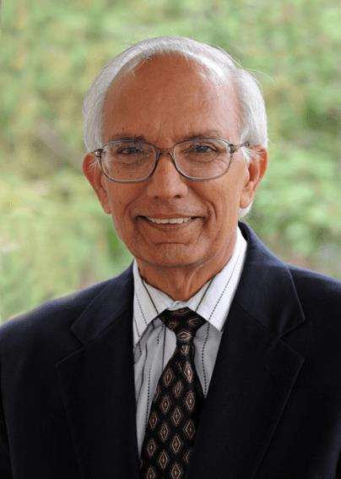
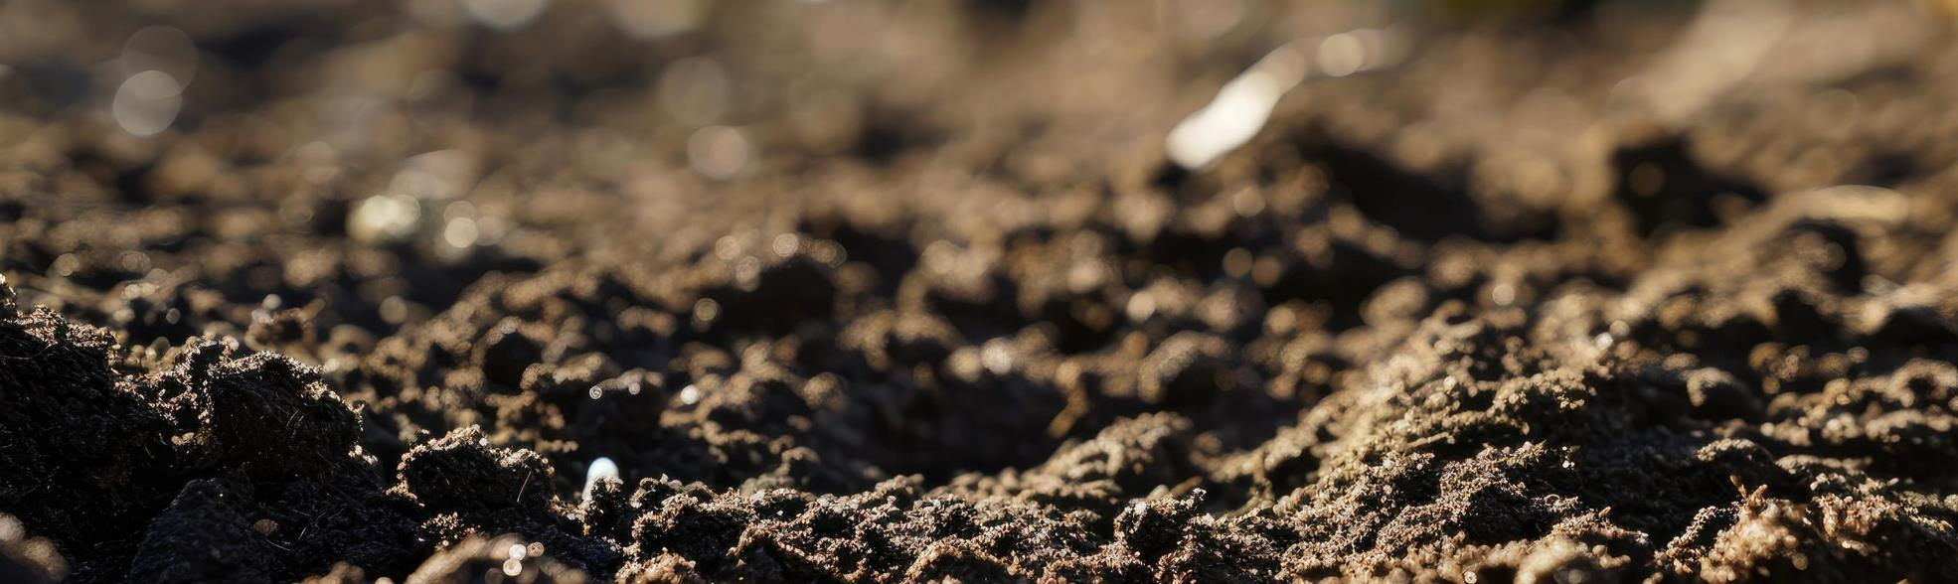
Faces of Our Field
Rattan Lal
Soil Scientist, The Ohio State University
Understanding soil as the foundation of a thriving civilization
“People are a mirror image of
the land they live on.”
Notes:
Rattan Lal (ruh-tahn lahl) grew up on a small farm in what was then British India and fled with his family during its tumultuous final years. They left modern Pakistan to cross the border into India, where his family plowed a small plot of land with oxen.
This experience instilled in him a deep appreciation for the land. In 1965, he flew to Ohio to pursue a PhD in soils. He has been a Society member since 1968.
Lal’s groundbreaking research on soil health and carbon sequestration has highlighted the critical role of soil in combating climate change. He believes that restoring soil health is essential for sustainable agriculture, food security, and environmental quality.
Note: This is a great video on Dr. Lal: https://www.youtube.com/watch?v=z1UW-AGnMck

Slide 5
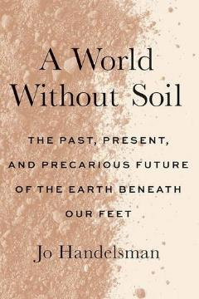
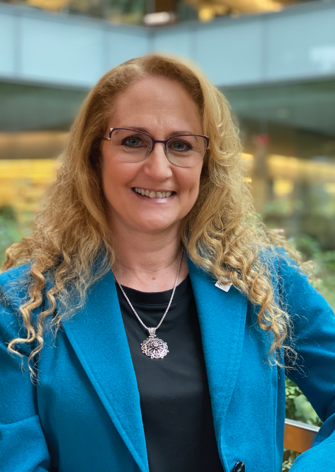
Faces of Our Field
Jo Handelsman
Soil Scientist, UW-Madison
Former associate director for science at the White House Office of Science and Technology Policy and science advisor to President Barack Obama​
“The gifts of the soil truly changed the course of human existence, removing such diseases as typhoid fever, tuberculosis, and typhus from the top ten causes of death in countries with antibiotics and making bacterial infectious disease treatable rather than deadly.”
Notes:
Jo Handelsman grew up in New York and developed a passion for science early on, inspired by her parents who were both educators. This love for science led her to pursue a PhD in Molecular Biology at the University of Wisconsin-Madison. She has been a prominent figure in microbiology and science policy, and a dedicated member of her professional society since the early 1990s.
Handelsman’s pioneering work in metagenomics has revolutionized our understanding of microbial communities. She is a strong advocate for increasing diversity in the sciences and has dedicated much of her career to mentoring the next generation of scientists.

Slide 6
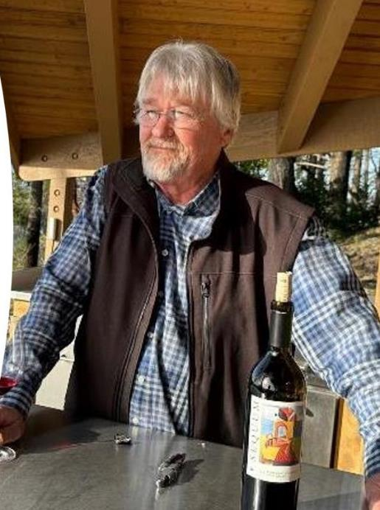
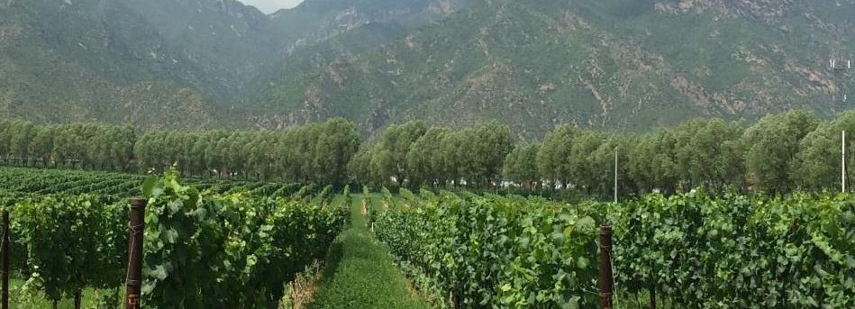
Faces of Our Field
Paul Skinner
Soil Scientist, Napa, Calif.
Revolutionizing Soil Data Collection on the Vineyard
Notes:
Now, you may not have heard of Paul Skinner. His use of advanced technology, like remote sensing and GPS, has been used in thousands of acres of vineyards and has revolutionized the connection between soil and wine.
Soil and crops have a wide-reaching impact on our world, and these sciences can change the world in unexpected ways. It also shows how you can apply our sciences to real-world challenges.

Slide 7
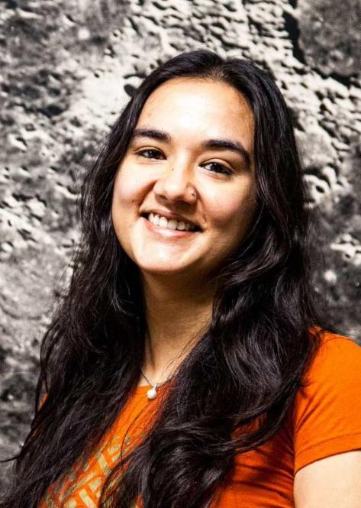

Faces of the Societies
Aditi Pandey
Postdoctoral Researcher, NASA
The unique environment of Mars offers a glimpse into chemistry that differs from what we see on warm and wet Earth. I am driven to discover the events that shaped the red planet's surface and why it's so different from Earth.
Notes:
Naturally, we talk a lot about science at the Societies. But the people who make it happen are at center stage. I’d like to share a few stories about people much like you who are behind the discoveries that are changing our world.
Dr. Aditi Pandey is a Postdoctoral Research Fellow at the Lunar Planetary Institute.
She uses advanced techniques—such as synchrotron-based X-ray and electron spectro-microscopic techniques—to understand the formation of minerals on Mars. Her work can tell us about Mars’ past environment and history.

Slide 8
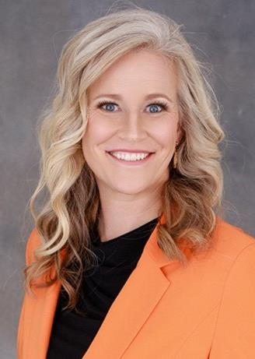
Faces of the Societies
Abbey Wick
Soil Health Upskilling and Outreach Group Leader, Syngenta
With my strong research background, I wanted to see the science put into action and then scale it. At Syngenta Group, I’m excited to integrated logistics with hard science in generational farming.
Notes:
Abbey creates soil health programs for Syngenta Group, helping her team learn new skills and share ideas globally. By building networks and combining science with practical approaches, she promotes long-term success in sustainable practices. Her background includes research in land reclamation and agriculture, focusing on soil health and crop management techniques.

Slide 9
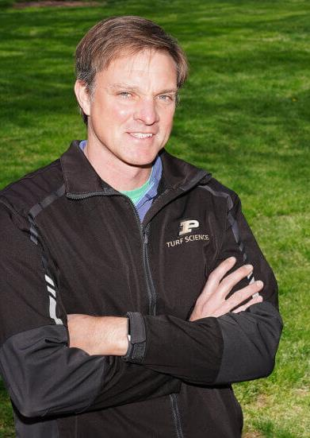
Faces of the Societies
Cale Bigelow
Turfgrass Scientist, Purdue University
For me personally, being on the CSSA board has been a way to give back to crop science, to help promote our Societies and plant sciences, and help ensure opportunities for current and future generations of scientists.”
Notes:
Cale Bigelow is an agronomy professor at Purdue University. He specializes in a field you might not immediately think of when considering crop science careers—turfgrass science.
His research focuses on managing and improving turfgrass systems, which includes everything from golf courses and athletic fields to your neighborhood lawns.
It's the sort of career that combines science, environmental stewardship and real-world applications.

Slide 10


Your Societies
  Founded in 1907
  More than 7,000 members and 12,000 Certified Crop Advisers
Mission: The American Society of Agronomy empowers people and communities to develop, disseminate, and apply novel agronomic solutions to sustain the world.
Notes:
DELETE IF NOT NEEDED
Speaker notes: Introduce yourself as board member of association.
Reminder:
As a board member of the American Society of Agronomy (ASA), it's important to emphasize that when you join our societies as a student, you're not only a member of ASA but also of our esteemed partner organizations, the Soil Science Society of America, often called SSSA, and the Crop Science Society of America, or CSSA.

Slide 11

Your Societies
  Founded in 1956
  More than 4,000 members
Mission: Discover and apply plant science solutions to improve the human condition and protect the planet.
Notes:
DELETE IF NOT NEEDED
Speaker notes: Introduce yourself as board member of association.
Optional reminder: As a board member of the Crop Science Society of America (CSSA), I want to highlight that when you become a member of our Societies as a student, you're automatically enrolled in our partner organizations, the Soil Science Society of America and the American Society of Agronomy.

Slide 12

Your Societies
  Founded in 1936
  More than 6,000 members and 500+ Certified Professional Soil Scientists
Mission: To advance knowledge and appreciation of soils as a foundation of life.
Notes:
DELETE IF NOT NEEDED
Speaker notes: Introduce yourself as board member of association.
Optional reminder: I am a board member of the Soil Science Society of America. As a student, when you join the Societies you’re also a member of our partner organizations, the Crop Science Society of America and the American Society of Agronomy.

Slide 13





Strategic Plan
We Shape the Future of Soil Science
Developing Our Workforce
Raising Our Visibility
Reaching Our Potential
We care deeply about growing the next generation of soil, crop, and agronomic scientists.
We feed the world amid a changing climate. Let’s spotlight that work.
We’re professionals who boost our earning power and prestige as a Certified Crop Adviser or Certified Professional Soil Scientist.
Notes:
We want to become your professional home, and to do that we have to think big.
Cultivating the next generation of scientists is a core part of our mission. It’s really why I’m standing in front of you today.
I hope the stories I’ve shared earlier, as well as the experiences you’ll have in higher education, communicate the opportunities these fields can unlock.
That includes showcasing the opportunities that our sciences offer as well as extending the reach of our K-12 program to inspire young people. I want to hear from you, the students, about what shapes your decision making about these sciences and how we could reach people like you more effectively.
We also offer certification options to agronomists and soil scientists so you can demonstrate your professionalism and grow your career. If you’d like to learn more about becoming a Certified Crop Adviser or Certified Professional Soil Scientist, find more information on Agronomy.org. Or just Google those terms!
Finally, do you think most people understand our work at even a basic level? We want to raise your visibility and that of our sciences. There are so many reasons to raise our collective profiles, but consider just one: funding. If the public doesn’t understand how we contribute to the greater good, public funding will inevitably suffer. So making sure we don’t stay behind the scenes isn’t vanity; it’s essential..

Slide 14

Strategic Plan
We Shape the Future of Crop Science
Developing Our Workforce
Raising Our Visibility
Reaching Our Potential
We care deeply about growing the next generation of soil, crop, and agronomic scientists.
We feed the world amid a changing climate. Let’s spotlight that work.
We’re professionals who boost our earning power and prestige as a Certified Crop Adviser or Certified Professional Soil Scientist.
Notes:
We want to become your professional home, and to do that we have to think big.
Cultivating the next generation of scientists is a core part of our mission. It’s really why I’m standing in front of you today.
I hope the stories I’ve shared earlier, as well as the experiences you’ll have in higher education, communicate the opportunities these fields can unlock.
That includes showcasing the opportunities that our sciences offer as well as extending the reach of our K-12 program to inspire young people. I want to hear from you, the students, about what shapes your decision making about these sciences and how we could reach people like you more effectively.
We also offer certification options to agronomists and soil scientists so you can demonstrate your professionalism and grow your career. If you’d like to learn more about becoming a Certified Crop Adviser or Certified Professional Soil Scientist, find more information on Agronomy.org. Or just Google those terms!
Finally, do you think most people understand our work at even a basic level? We want to raise your visibility and that of our sciences. There are so many reasons to raise our collective profiles, but consider just one: funding. If the public doesn’t understand how we contribute to the greater good, public funding will inevitably suffer. So making sure we don’t stay behind the scenes isn’t vanity; it’s essential.

Slide 15

Strategic Plan
We Shape the Future of Agronomic Science
Developing Our Workforce
Raising Our Visibility
Reaching Our Potential
We care deeply about growing the next generation of soil, crop, and agronomic scientists.
We feed the world amid a changing climate. Let’s spotlight that work.
We’re professionals who boost our earning power and prestige as a Certified Crop Adviser or Certified Professional Soil Scientist.
Notes:
We want to become your professional home, and to do that we have to think big.
Cultivating the next generation of scientists is a core part of our mission. It’s really why I’m standing in front of you today.
I hope the stories I’ve shared earlier, as well as the experiences you’ll have in higher education, communicate the opportunities these fields can unlock.
That includes showcasing the opportunities that our sciences offer as well as extending the reach of our K-12 program to inspire young people. I want to hear from you, the students, about what shapes your decision making about these sciences and how we could reach people like you more effectively.
We also offer certification options to agronomists and soil scientists so you can demonstrate your professionalism and grow your career. If you’d like to learn more about becoming a Certified Crop Adviser or Certified Professional Soil Scientist, find more information on Agronomy.org. Or just Google those terms!
Finally, do you think most people understand our work at even a basic level? We want to raise your visibility and that of our sciences. There are so many reasons to raise our collective profiles, but consider just one: funding. If the public doesn’t understand how we contribute to the greater good, public funding will inevitably suffer. So making sure we don’t stay behind the scenes isn’t vanity; it’s essential.

Slide 16




Notes:
DELETE IF NOT NEEDED
Presenter notes: While most of our more than 7,000 members live in the United States, we have members in 61 countries.
Our Global Outreach Membership Program is designed to provide equitable access to scientific research and colleagues worldwide for scientists and students residing in low and lower-middle-income countries.

Slide 17

Notes:
DELETE IF NOT NEEDED
Presenter notes: While most of our more than 4,000 members live in the United States, we have members from around the world.
Our Global Outreach Membership Program is designed to provide equitable access to scientific research and colleagues worldwide for scientists and students residing in low and lower-middle-income countries.

Slide 18



Notes:
DELETE IF NOT NEEDED
Presenter notes: While most of our more than 6,000 members live in the United States, we have members from around the world.
Our Global Outreach Membership Program is designed to provide equitable access to scientific research and colleagues worldwide for scientists and students residing in low and lower-middle-income countries.

Slide 19













Our Journals
We publish 13 peer-reviewed journals
Open-access
(anyone can read)
Hybrid-access
(subscription required for some content)
Notes:
Presenter notes:
Our three nonprofit societies own and publish 7 hybrid subscription and 6 open access scholarly research journals.

Slide 20
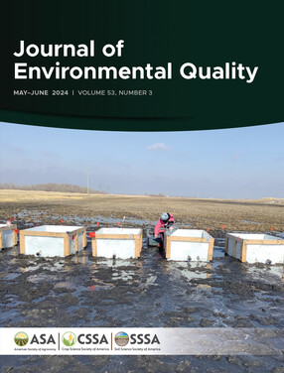
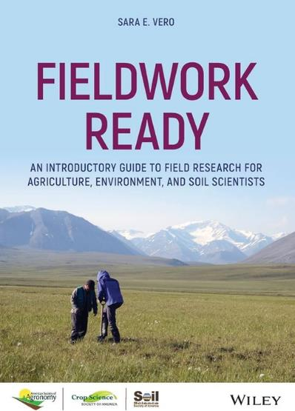
Why publish with us?
Reinvesting in our sciences
  As nonprofits, we funnel proceeds back into the sciences
  We are dedicated to open science
  We support you along the way
Notes:
Publishing with professional societies allows for reinvestment in your field through missioned-based programs in education, awards, travel grants, science policy and certifications. In addition, the ASA, CSSA, and SSSA are dedicated to open science and publicly available and accessible research.

Slide 21

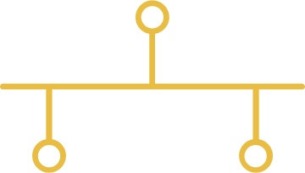
Publishing Process
Submit your
manuscript
Initial editorial
evaluation
Revisions
(if needed)
Manuscript
accepted
You are
published!
1
3
5
7
9
2
4
6
8
Internal tech
screening & checks
Peer
review
More peer review
(if needed)
Copy editing
& proofing
Notes:
Presenter notes: Publishing in an academic journal can be a complex process. As a publisher, your Societies want to be your partner.

Slide 22
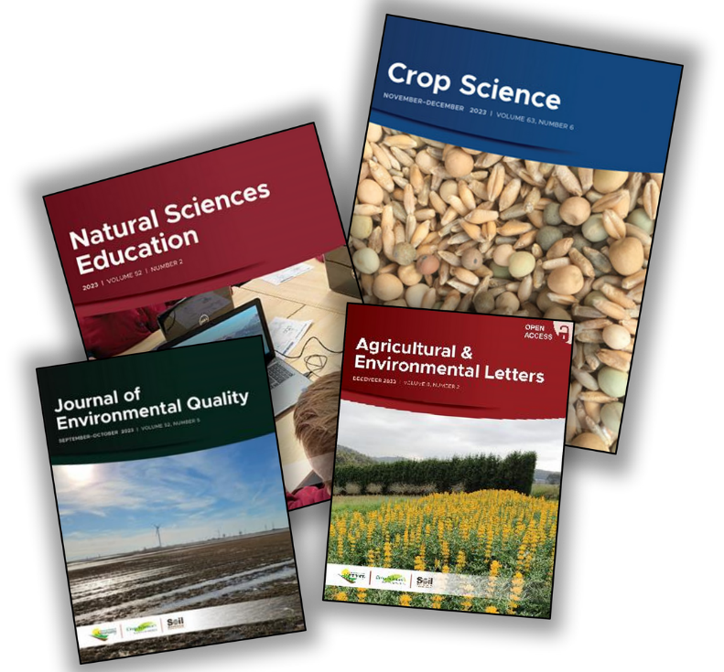
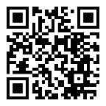
Transformational Agreements
  Fund authors to cover open access licensing fees
  Provide researchers unlimited access to our complete collection of scientific, peer reviewed journals
  Worldwide agreements are established with numerous institutions, consortia, and countries
Scan the QR code to see if your university is covered:
Notes:
Presenter notes:
Transformational agreements have been established on behalf of ASA, CSSA, and SSSA by with individual institutions, consortia, and even entire countries, to provide researchers unlimited read access to our portfolio of journals, as well as funding to fully cover open access licensing charges.
Transformational agreements (TAs) are the primary tool used to manage open access publishing for our authors. The ASA, CSSA, and SSSA, through our partnership with Wiley, are facilitating the transition of our hybrid subscription journals towards open access with a sustainable outlook.
Controlled transition to freely available content ensures sustainability and supports researcher needs and our journals are fully committed to supporting open access and providing freely accessible content.
Transformational agreement activity changes quickly. For more information on current agreements, scan the QR code on the screen

Slide 23
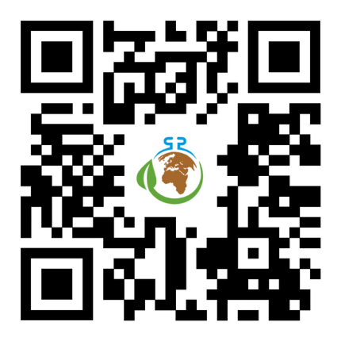

Podcast & Student Spotlight
Features timely conversations with authors in a fun, accessible tone.
We’re looking for students to feature on the podcast. Scan the QR code to be featured.
Notes:
Our podcast, Field, Lab, Earth, raises the profile of our authors while offering listeners a new way to learn. We’re always looking for student research to spotlight, so if you know of anyone who might be interested to appear on the podcast, please don’t hesitate to fill out or share this form.

Slide 24


The Mark of Certification
  12,000+ Certified Crop Advisers (CCAs)
  Largest voluntary certification program in agriculture
  Intended for working agronomists and related fields
  500+ Certified Professional Soil Scientists (CPSS)
  Intended for those in the soil science profession
Notes:
Presenter notes:
Certification sets the standard for professionals.
Our Societies offer two main certification programs.
One, called the Certified Crop Adviser Program, mainly serves working agronomists. These are people who spend most of their time advising growers on agronomic practices.
The second is the Certified Professional Soil Scientist Program. And that's intended for someone whose career path is in some aspect of the soil science profession and can meet the standards of the program.
The goal of both programs is to provide assurance to employers, growers and others that there are working with people committed to serving and protecting the public interest.

Slide 25
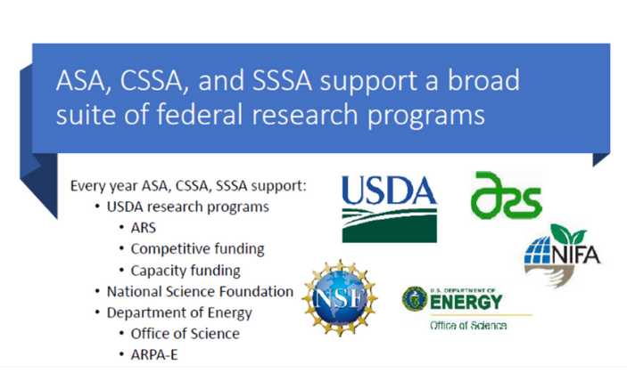
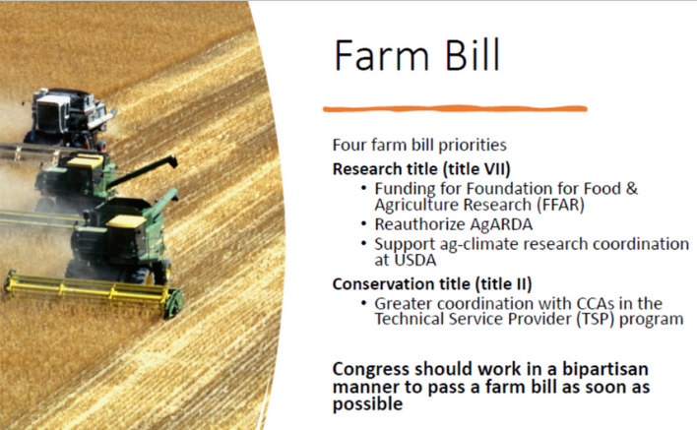
Science Policy
Federal policy matters. We’re advocating for your interests on Capitol Hill regarding:
  Research funding
  The Farm Bill
  Climate change policy
We’ll help you get involved:
  Congressional Visits Day: Annual event bringing dozens of members to D.C.
  SEED Ambassador Program: Support to develop relationships with lawmakers
Notes:
Our podcast, Field, Lab, Earth, raises the profile of our authors while offering listeners a new way to learn. We’re always looking for student research to spotlight, so if you know of anyone who might be interested to appear on the podcast, please don’t hesitate to fill out or share this form.

Slide 26




Keep Learning
Educational opportunities that fit your life
Webinars
Online Courses
Decode 6
Online Classroom
Join experts who share practical and scientific information
Foundations of Applied Agronomy is a set of online courses
Packed with information on soil carbon, ecosystem services, and sustainable ag
Articles, podcasts, and videos on timely topics
Share What You Know! Want to plan a webinar? Author an article? Write a book? We can help!
Notes:
We want to become your professional home, and to do that we have to think big.
Cultivating the next generation of scientists is a core part of our mission. It’s really why I’m standing in front of you today.
I hope the stories I’ve shared earlier, as well as the experiences you’ll have in higher education, communicate the opportunities these fields can unlock.
That includes showcasing the opportunities that our sciences offer as well as extending the reach of our K-12 program to inspire young people. I want to hear from you, the students, about what shapes your decision making about these sciences and how we could reach people like you more effectively.
We also offer certification options to agronomists and soil scientists so you can demonstrate your professionalism and grow your career. If you’d like to learn more about becoming a Certified Crop Adviser or Certified Professional Soil Scientist, find more information on Agronomy.org. Or just Google those terms!
Finally, do you think most people understand our work at even a basic level? We want to raise your visibility and that of our sciences. There are so many reasons to raise our collective profiles, but consider just one: funding. If the public doesn’t understand how we contribute to the greater good, public funding will inevitably suffer. So making sure we don’t stay behind the scenes isn’t vanity; it’s essential.

Slide 27
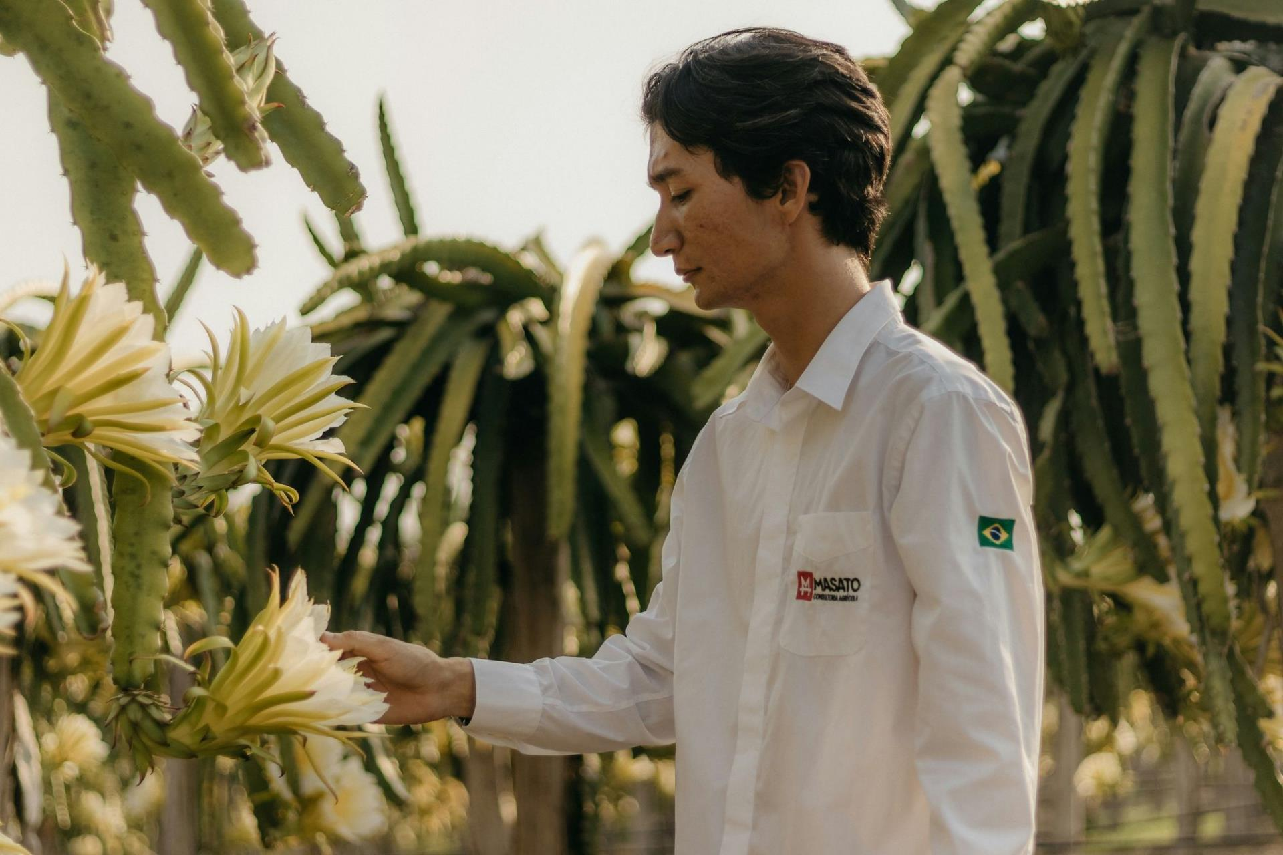

Advancing Careers
Launching Your Professional Journey
Notes:
No matter where you’re at in your career—undergraduate, grad student, post doc—membership in a society of your peers can give you a step up.
From access to cutting-edge research and industry insights to mentorship programs and professional development opportunities, our association is dedicated to empowering you to reach your full potential.

Slide 28
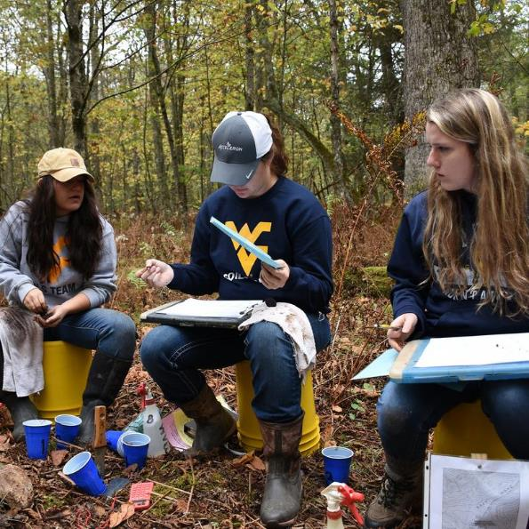

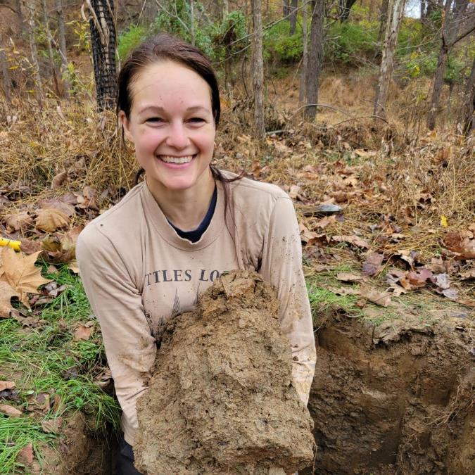
Find your people
Connecting people, advancing science
Connecting students
  Scholarships
  Research grants
  Internships
  Events
  SASES
Notes:
Presenter notes: We understand the importance of nurturing the next generation of scientists. That's why we offer special programs and opportunities specifically tailored to students, including scholarships, research grants, and internships.
As a student, you may have heard the acronym “SASES” (pronounced “say-sez”). It stands for Students of Agronomy, Soils, and Environmental Sciences, and it brings students together for events and contests, including at the Annual Meeting, held each fall. This year (2024) it’s in San Antonio in November, and next year it will be in Salt Lake City.
The Societies also strive to create an environment where people from diverse backgrounds can succeed. We provide programs and resources to foster the success of under-represented groups in our sciences.
We offer mentoring programs and scholarships tailored to support individuals from underrepresented backgrounds in their pursuit of careers in agronomy, crop science, and soil science.

Slide 29
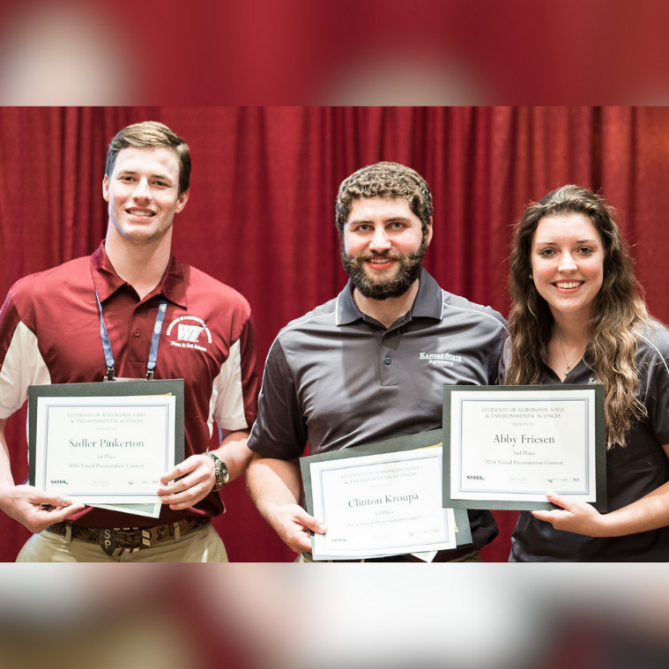
Earn awards & scholarships
Get recognized
Students have many opportunities to be recognized, including:
  Scholarships to attend the Annual Meeting and other events
  Golden Opportunity Scholars
  Greenfield Scholars
Notes:
Presenter notes:
Each year, dozens of students are recognized with awards and scholarships. Joining our Societies opens up new opportunities to network with professionals, enhance resumes or CVs, and may provide financial support for education or research.

Slide 30
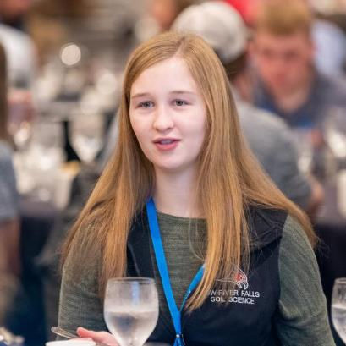
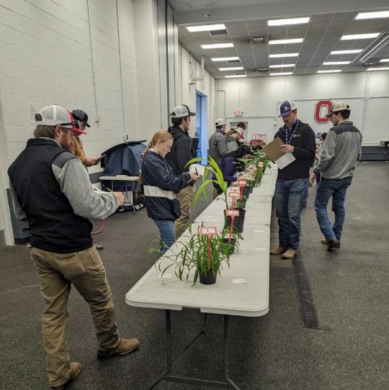
Networking opportunities
Let us be your professional home
We can provide the resources you need to advance your careers, no matter what career stage you’re in.
Undergraduates
  Scholarships
  Awards
  Contests
Graduates
  Review
  Publish
  Attend grad-specific events, webinars
Notes:
Presenter notes: Getting the most out of your college experience means networking. And that’s an area we specialize in.
For example, this picture shows a student crop judging contest.

Slide 31
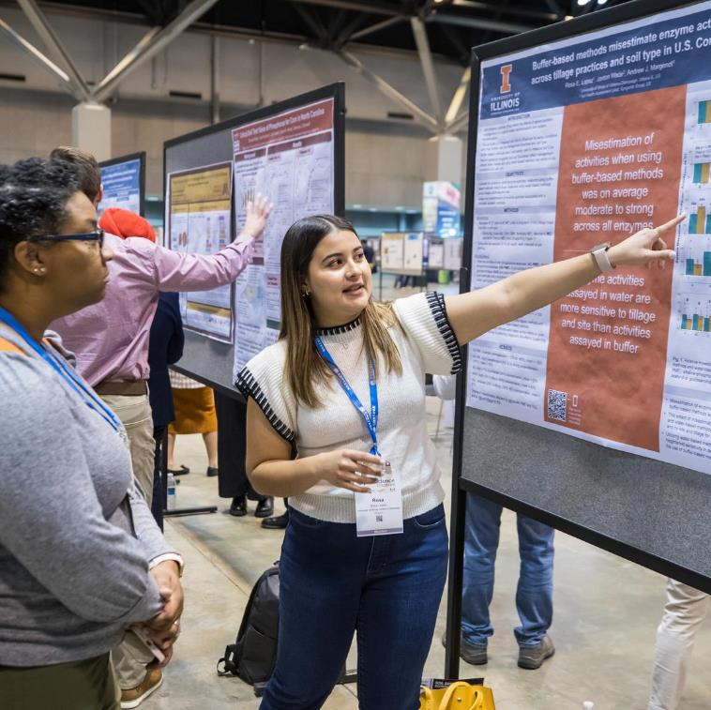
Present your research
Sharing your findings
Researching, organizing, and writing articles for publication can be stressful. We want to help.
  Publication discounts
  Mentorship
  Annual Meeting, where all abstracts are accepted
Notes:
Presenter notes:
Our Societies together publish 13 journals, and we want to be your partner in publication. While you don’t have to be a member to publish, membership means you get publication discounts and access to the entire online library.
The Darrel S. Metcalfe Student Manuscript Contest is one way for undergrads interested in our sciences to gain experience in the entire publication process, from conception through execution.
All undergrad members are eligible, and up to three winners will be published in *Natural Sciences Education.*
The Annual Meeting is a fantastic way to be introduced to publishing. All abstracts are accepted, so you have nothing to lose by submitting and gaining vital publishing experience.

Slide 32
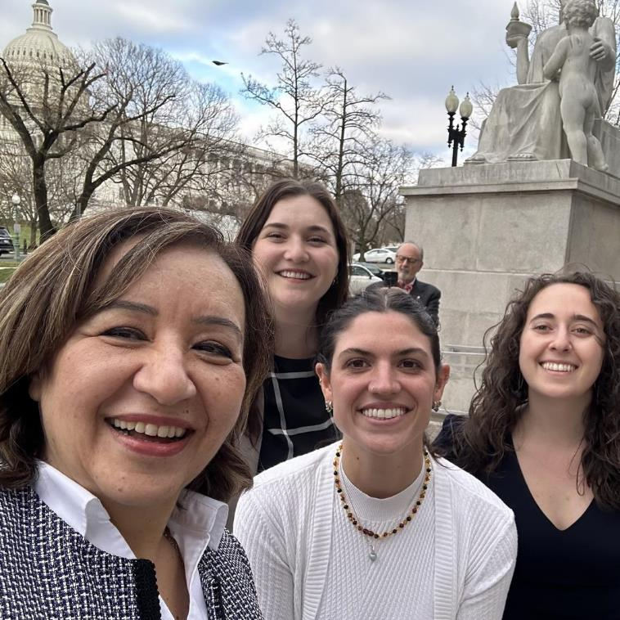
Communicate with the public
Raise your science communication game
Hone your skills at:
  Annual Meeting
  Congressional Visits Day
  Student group meetings
Notes:
Presenter Notes: First, I’d like to note this is a picture of the 2024 Congressional Visits Day, in which several dozen of our members travel to Washington, D.C. to advocate for publicly funded science. Strong communication skills are essential for success in any career, including scientific research. Whether presenting findings at conferences, writing research papers, or collaborating with colleagues, students who can communicate effectively are better positioned for success in their future careers.

Slide 33

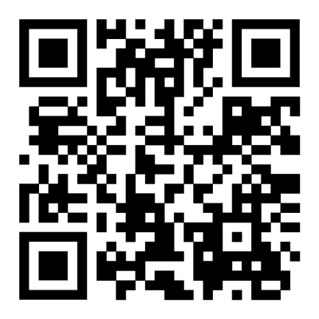
Find internships
Use our career center
Looking for an internship, post-graduate opportunity or a job?
Search our career center for openings.
Notes:
We also want to help you experience the hands-on experience and professional networking that an internship can provide.

Slide 34

Now what?
Life after graduation
You may be searching for a job. You may be choosing a field of graduate study. Either way, the Societies can help.
Notes:
Whether you’re an undergrad or grad student, you have important choices ahead.
No matter your education and career path, membership in our Society can help you move into your future with confidence.
Curious about where your passions lie? Our Societies are organized into dozens of subspecialties, typically called communities and sections.
Whether you’re into sensor-based nutrient management, turfgrass science, wetland soils, or any of the dozens of subspecialties, you can find a community of professionals able to help offer you guidance.
If you’re moving into an agronomic career after graduation, I encourage you to explore certification as a certified crop adviser.

Slide 35


My Story
How I Got Here
Notes:
This is a chance for the presenter to talk about their career journey. Try to relate it to where the students are in their lives. There are some suggested items to note:
- your time as a student/choosing a career path
- bonus points for including the Societies in your story

Slide 36



What resonates with you?
Where do you go to get inspired?
Notes:
Methods of communication evolve rapidly, and we want to make sure our message and information reach our audience. Where do you look for information? Social media? Reddit? Do you still read your emails? Do we need to start pumping out soil memes?
We want to meet you where you are; where are you?

Slide 37

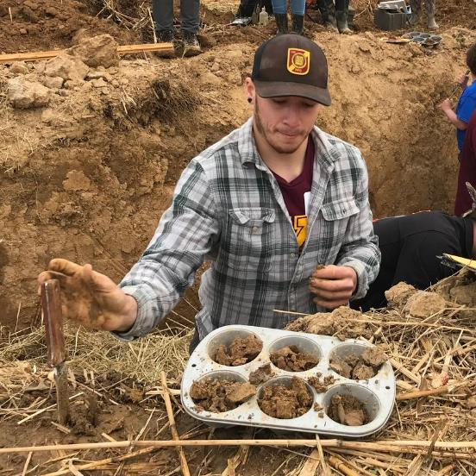
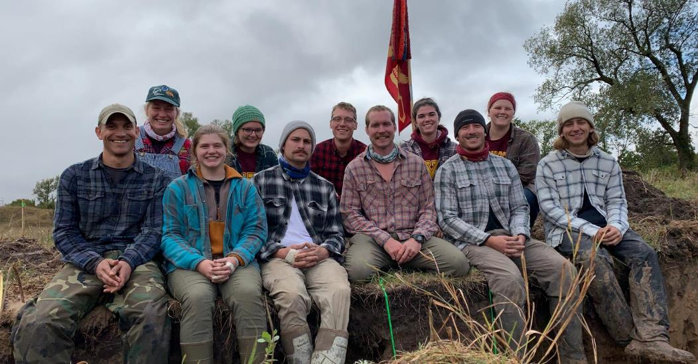
Join us!
Where science meets community
Notes:
We’re not just about soil horizons and plant genetics. Though we are very much about the science, we know that people are behind the discoveries that are changing our world.
Our association is more than just a collection of scientific disciplines; it's a vibrant network of like-minded individuals who support and inspire each other.

Slide 38
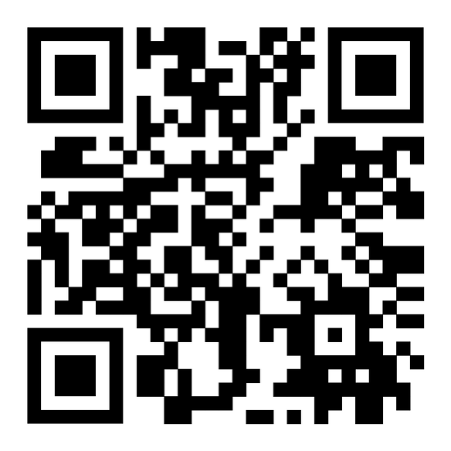
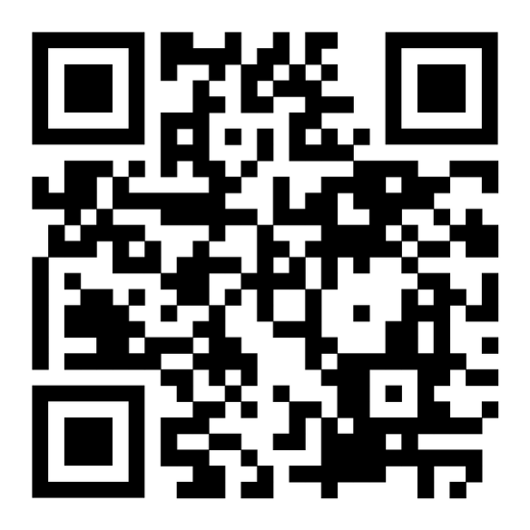
Become a member today
Undergraduates
Dues: $30
Graduates
Dues: $50
Notes:
We’re not just about soil horizons and plant genetics. Though we are very much about the science, we know that people are behind the discoveries that are changing our world.
Our association is more than just a collection of scientific disciplines; it's a vibrant network of like-minded individuals who support and inspire each other.

Slide 39

Have a Question?

Slide 40
Thank You!

