Slide 1


CCA
Marketing Overview
Presented by
Hanna Jeske
Associate Director of Marketing and Brand Strategy
June 6, 2024

Slide 2

Phase 1
Email Campaigns & Tactics
02
01
Regular emails to our prospect list selling the virtues of the CCA Program
The Why
Tactics
  Reaching out to warm leads aims to reignite interest, drive completion, and fortify our certification program's community and reputation. By nurturing and retaining these individuals, we strengthen our program's numbers and foster a sense of belonging among certified professionals. Ultimately, this campaign's impact extends beyond immediate conversions, contributing to the long-term growth and credibility of our certification program.
  Build an email campaign that is central to window testing dates to target lapsed CCAs, system users who may have created an account but never became certified.
  New this year, marketing built an awareness campaign that targets students, ASA members, webinar attendees and industry members. This gives potential CCAs time to create an account, research the CCA program, and understand the benefits of becoming certified.
  Create emails that are well-designed, engaging and have clear calls to actions.

Slide 3

Phase 2
Strategic Storytelling & Tactics
Telling the CCA Program story in new & better ways
Using the names, faces & stories of CCAs themselves
01
02
Tactics
8,173
The Why
7,783
We are revamping our content through testimonials and collateral that is engaging and captivating.
Creating a platform for CCA Admins to customize marketing material to their region.
We are creating a form that CCA can fill out to generate testimonials about how the CCA program has benefited them and how it has helped their career. These testimonials can be used internationally and regionally.
These tactics enhance the CCA program's reach and impact by showcasing its benefits both locally and globally. Providing a platform for CCA Admins to customize marketing materials ensures flexibility and authenticity with region-specific images while maintaining a consistent and streamlined look.

Slide 4
Phase 3
State, Regional, Provincial Collaboration
Create templated marketing materials that can be delivered at the local/regional level
02
Complementary efforts – Tri-Societies staff works internationally; boards work locally/regionally
01
Tactics
The Why
Gain insight into the marketing requirements of the local boards. What specific marketing materials are you seeking?
Create a centralized platform for local boards to access customizable marketing content, empowering you to easily alter images according to their specific needs.
We're creating a centralized platform to provide local boards with customizable marketing content, ensuring consistency in appearance and messaging. This unified approach reinforces our brand identity, enhances recognition, and builds trust with our audience. Maintaining a cohesive brand image adds professionalism to our marketing efforts, contributing to our overall success.

Slide 5

Phase 4
Partnership Engagement & Tactics
01
02
Tactics
The Why
Collaborate with regional, state, and provincial entities to engage with NRCS, ARS, endorsing institutions, and leading companies that stand to gain from participation in the CCA program.
This tactic is important because it expands the reach of the program, increasing awareness among key stakeholders in the agricultural community. Secondly, it strengthens partnerships with influential organizations, enhancing the credibility and reputation of the CCA program. Thirdly, by involving NRCS, ARS, endorsing institutions, and top agronomic companies, we leverage their expertise and resources to provide valuable support and resources to aspiring CCAs.

Slide 6

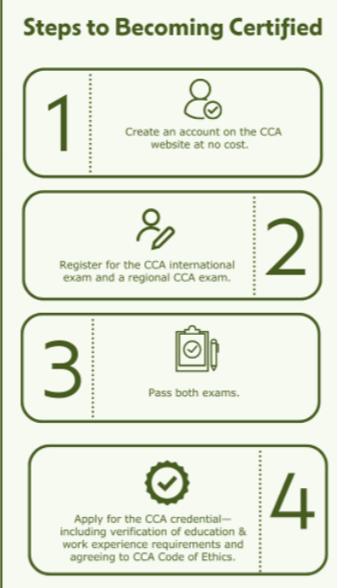


Tactics under Development or that Have Been Deployed
New Collateral
Broadcast Email
Digital Advertising

Slide 7
Other Marketing Initiatives
01
02
03
Complete Rebrand
Digital Strategies
Social Media
We're undergoing a complete rebranding initiative to standardize the CCA Program, ensuring consistency, accuracy and clarity across all material, channels and strategies.
Reach prospective CCAs with Feathr a digital marketing platform that spotlights the CCA program and window testing through geo-targeting high-traffic areas, engaging lookalike audiences, serving ads based on keyword testing, and target audiences that come to our website.
Streamline social media both at the ICCA level and at the state, region and province level to ensure we are create cohesive and effective outreach.
Overall website redesign across societies—to include CCA Program
Notes:
Feathr:
Audience Targeting: Feathr allows users to define their target audience based on various criteria such as demographics, interests, behaviors, and past interactions. This ensures that ads are shown to people who are most likely to engage with them.
Geotargeting: Feathr enables geotargeting, which means ads can be shown to people in specific geographic locations. This is useful for targeting audiences in particular cities, regions, or countries where the event or product is relevant.
Lookalike Audiences: Feathr helps create lookalike audiences, which are groups of people who share similarities with an existing audience (e.g., past event attendees or website visitors). By analyzing data from the existing audience, Feathr identifies patterns and characteristics and then finds new people who resemble them. This allows marketers to expand their reach to a broader audience that's likely to be interested in their event or product.

Slide 8
Facts & Figures
01
02
03
Email open rates average ~50%
Click rates of 5-6%
Sent to audiences of 16K+
Exam registrations up significantly
  1,263 in Q1 of 2024
  # was 1,187 in all of 2023
Revenue increasing proportionally
Significant contributor to ASA’s 1Q net income (profit), an improvement of $383K

Slide 9
Where are We Headed?
2024 & Beyond
01
02
03
Objective
Assessment
Identifying Solutions
Marketing’s primary goal for 2024 is to boost certification registrations and retain those that are already certified.
Marketing is evaluating our current marketing collateral, identifying areas where we streamline the user experience, and enhance our audience reach. However, our evaluation is still underway.
This is what we have currently identified. We are creating a new brand standard that will be implemented at the ICCA level and that States, Regions and Provinces can implement. This includes collateral, digital initiatives and user experience.

Slide 10
Have a Question?

Slide 11
Thank You!

