Slide 1


The Concept of
“CCA Membership” +
CCA Needs Assessment
25 September 2024

Slide 2

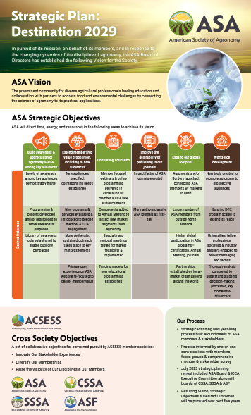
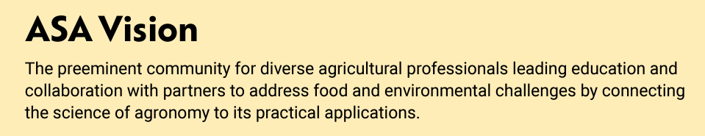
Why We’re Having this Conversation

Slide 3
CCA Membership Task Force
ASA Board of Directors
ICCA Board
Andy Knepp
ICCA Board Rep to ASA Board
Peter Kyveryga
President-Elect
Wade Thomason
Incoming President-Elect
Calvin Trostle
Nicole Fiorellino
Aaron Breimer
Incoming Chair
Jamie Perry
Peter Naumann

Slide 4
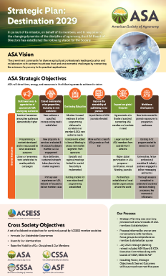
Process
ASA/CCA Board Task Force
CCA Needs Assessment
ICCA Board Discussion
Continued Conversation
Recommendations to ASA Board
Define a Path Forward
November
2025

Slide 5





What This Exercise Is NOT…
All of this BEGINS w/ the understanding that the needs of CCAs are fundamentally different than of traditional ASA members
MEMBER

Slide 6
Traditional ASA Member Benefits
All of this BEGINS w/ the understanding that the needs of CCAs are fundamentally different than of traditional ASA members
Publishing research in scholarly journals
Presenting research at Annual Meeting
Representation in Washington, DC (research funding)
Networking w/ fellow members (students, scientists)
Support of large-scale initiatives
Connection to application of science through the CCA network

Slide 7
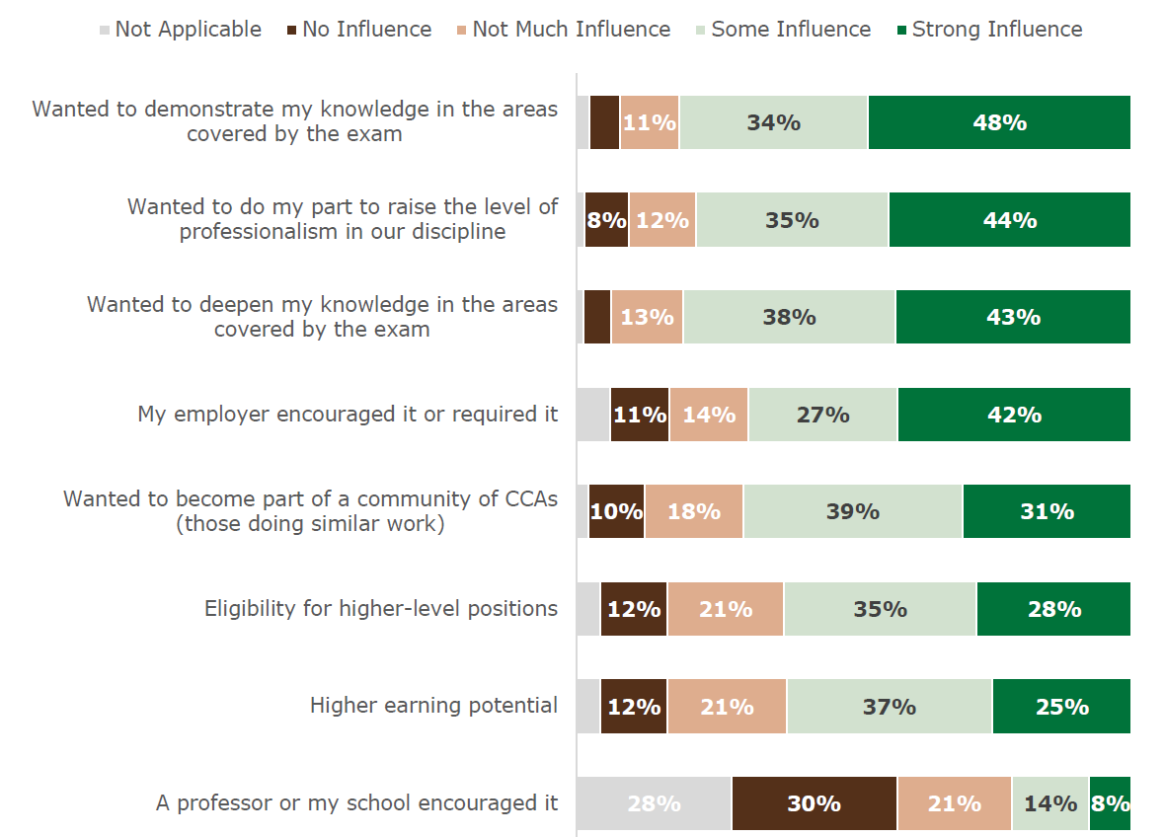
At Least Some Influence
Powerful Messages for Marketing
82%
79%
81%
Foundation for Deeper Engagement
69%
70%
63%
62%
22%

Slide 8
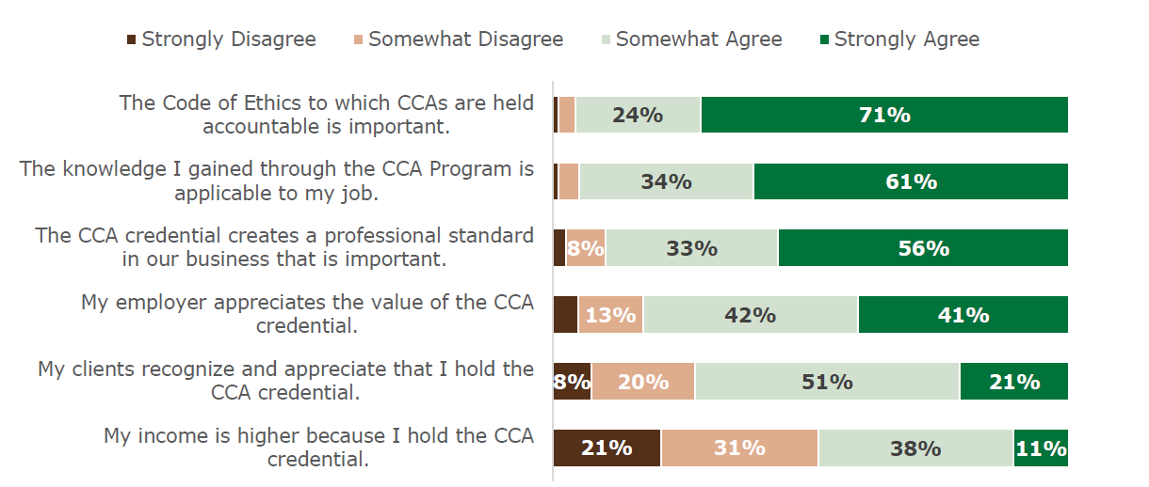
A Position of Strength
This is solid (we can build off this)
Work to do here (together)
Agree
95%
95%
89%
83%
72%
49%

Slide 9
Q6: What changes would you like to see in the CCA Program?
Enhanced farmer engagement & education
Improving the flexibility of earning CEUs
Emphasizing specialized education in areas like precision agriculture, carbon sequestration & bio-stimulants
Increasing the awareness & appreciation of CCA credential
Simplifying CEU requirements, improving the tracking system

Slide 10
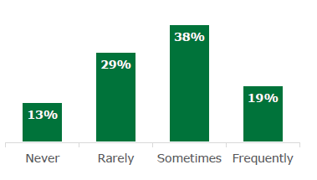
57%
86%

Slide 11

Typical Member Benefits
Pay Dues
Receive a Magazine
Get Education
Hold an Organization’s Credential(s)
Define a Profession
Belong to a Local Chapter
Volunteer Their Time
Partake in Networking & Other Types of Programs
Earn Awards
They get “member benefits”
They pay “dues”
They refer to themselves as members

Slide 12
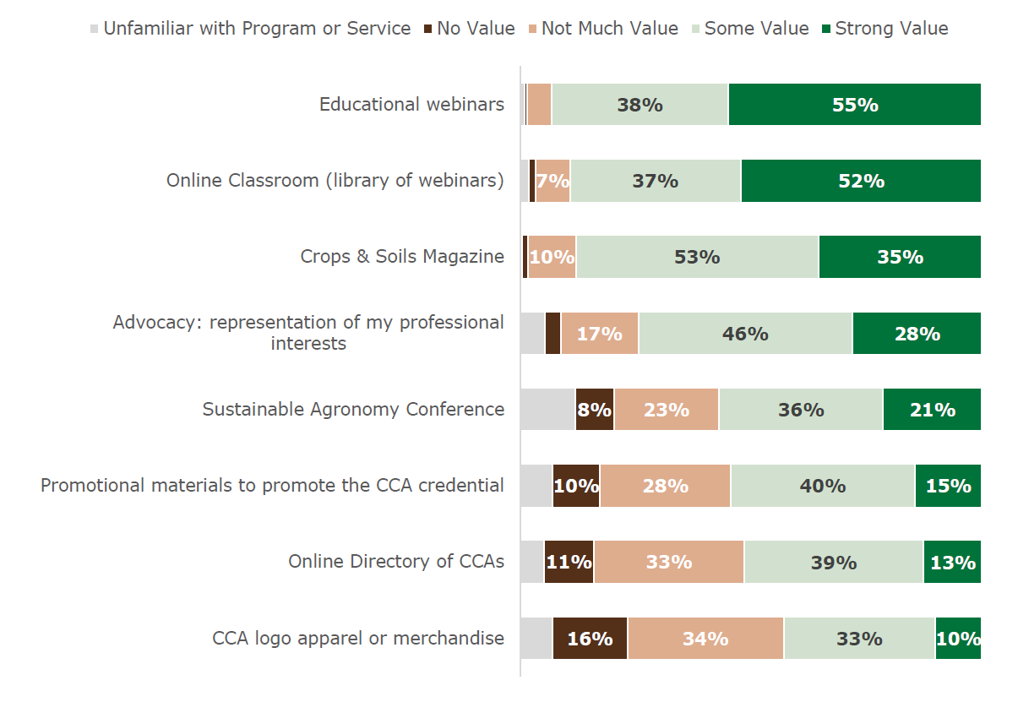
Value of Programs & Services
At Least Some Value
93%
89%
88%
74%
57%
55%
52%
43%

Slide 13
Q14: CCAs: Biggest problem you or your employer face(s)?
Employee recruitment & retention
Not enough flexibility/opportunity to earn CEUs
Government regulation & policies
Market & competitive pressures
Keeping up w/ advanced technologies
Needs/interests different than most ASA members

Slide 14
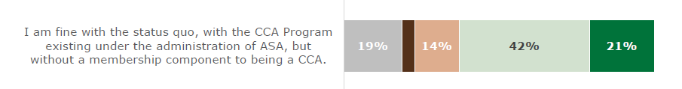
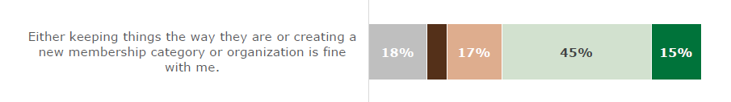
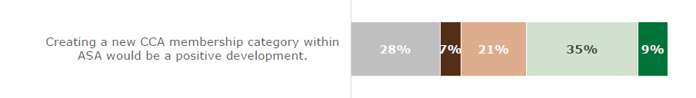
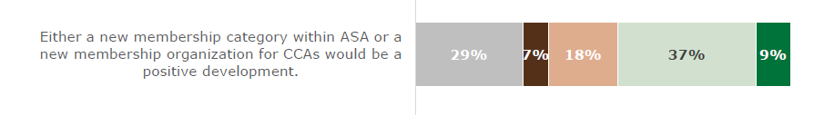
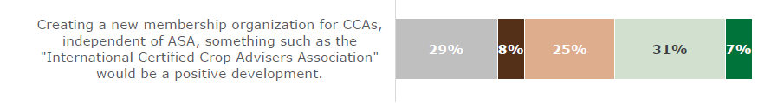
Agree (at least “somewhat”)
63%
59%
44%
46%
38%
Some Opposition + Indifference

Slide 15

With More Context
More Likely
86%
89%
All of this BEGINS w/ the understanding that the needs of CCAs are fundamentally different than of traditional ASA members
87%
83%
80%
80%
74%

Slide 16

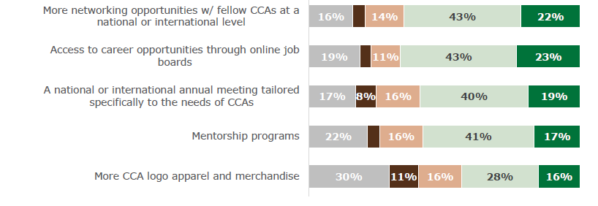
Part II
More Likely
65%
66%
59%
58%
44%
Even these numbers ain’t nothin’

Slide 17
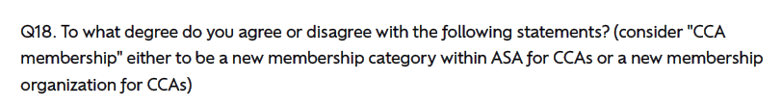
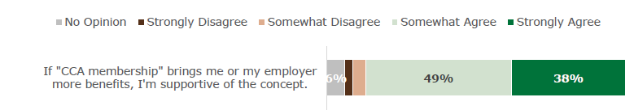



Less Indifference
Agree
87%
81%
67%
71%
59%

Slide 18
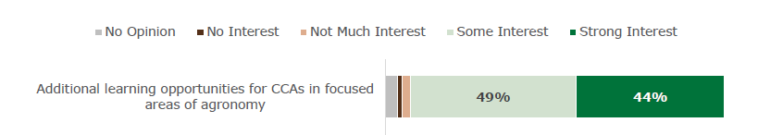




At Least Some Interest
93%
80%
72%
71%
63%
64%

Slide 19
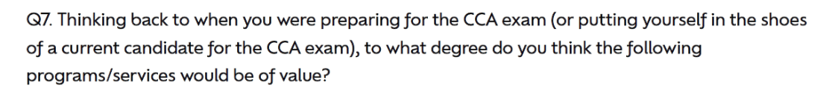


At Least Some Value
98%
96%
89%
84%
72%

Slide 20
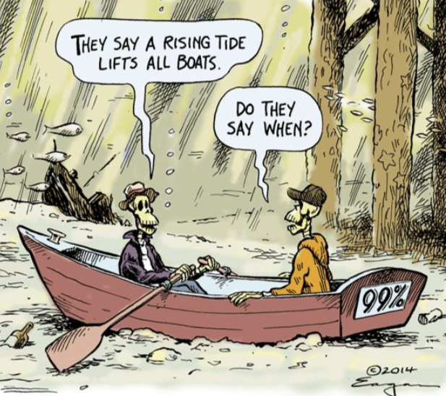
Benefits on Many Levels
For candidates in CCA Program
For CCAs
For employers of CCAs
For ASA
For ICCA
For state, regional boards

Slide 21
Discussion: 3 Potential Models
CCA Membership Category under ASA Umbrella
New Membership Organization under ACSESS Umbrella
Status Quo w/ Commitment to New CCA-Focused Programs & Services
Certified Member category already exists
Connection of agronomic science to its application through CCA Program remains prominent
Permissible under umbrella of ACSESS
Perhaps a more explicit statement that we are serious about this
Obviously the easiest of the scenarios
But perhaps is accompanied by lack of urgency that leads to inaction?

Slide 22
Process
Looking for 5-7 reps from boards for continued conversation
ASA/CCA Board Task Force
CCA Needs Assessment
ICCA Board Discussion
Continued Conversation
Recommendations to ASA Board
Define a Path Forward
November
2025

