Slide 1
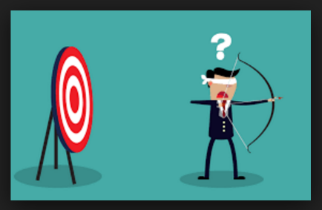
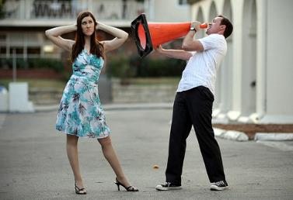

An Economy of Attention
A Currency of Disinformation
A Deficit of Trust
Kevin M. Folta, Professor
Horticultural Sciences Department
@kevinfolta

Slide 2
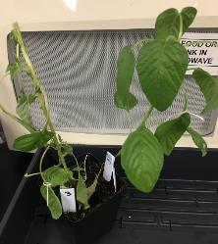

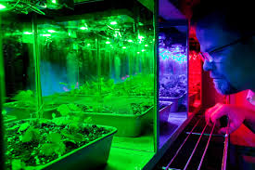
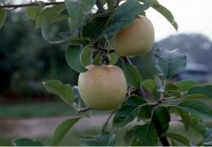
Research Programs
Strawberry genomics
Novel small molecule growth regulators
Light and plant traits in controlled environments
New Crops for Florida
Funding : Currently no research funding support

Slide 3
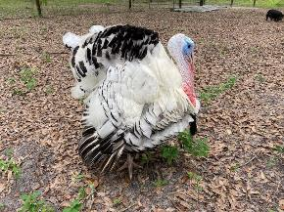
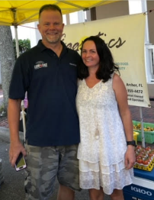
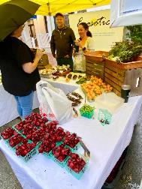
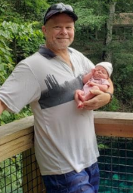
We grow seasonal fruit/veg and raise animals on 18 acres near Archer, FL
Peaches, Jujube, Apples, Citrus, Feijoa
Mulberry, Persimmons, Blackberry,
Strawberry, Pears, Papaya, Watermelons
Starfruit, Figs, Guava, Blueberries, Muscadine Grape, Avocado
Seasonal vegetables
Chicken/Duck Eggs
Heritage breed turkeys, ducks and chickens
Idaho Pasture Pigs, artisan sausage, pork products
Farmers Markets, Restaurants, Local Markets

Slide 4
My most important role is in extension

Slide 5
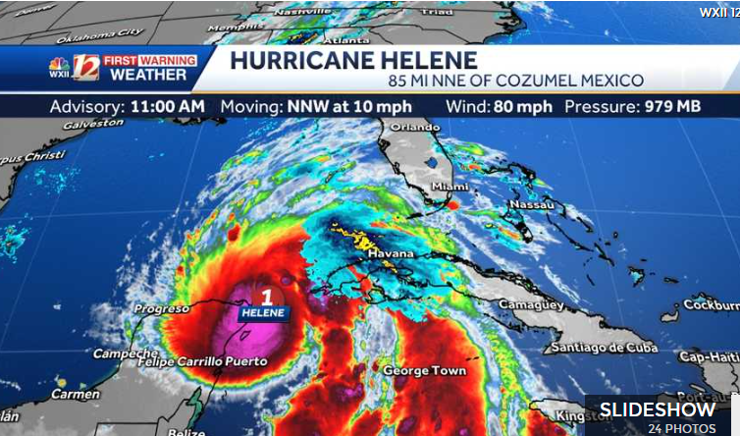

Slide 6
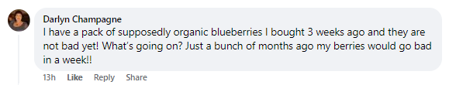
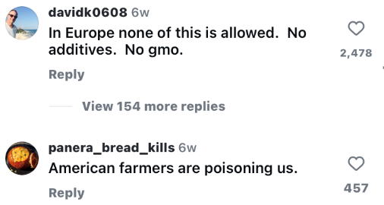
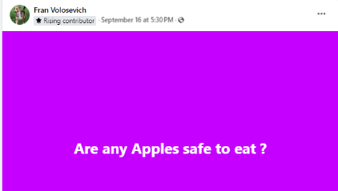
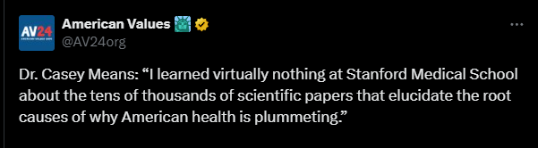

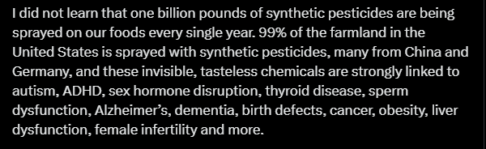


Slide 7
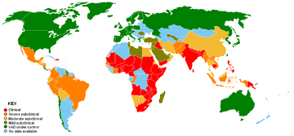
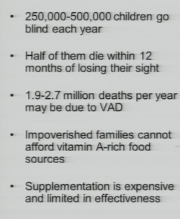
Micronutrient deficiency
Deficiencies in vitamin A, zinc, and iron lead to millions of deaths each year
Biofortification of crops may help
Approved for use in the Philippines (sort of)

Slide 8
Micronutrient deficiency
Deficiencies in vitamin A, zinc, and iron lead to millions of deaths each year
Biofortification of crops may help
Approved for use in the Philippines (sort of)

Slide 9
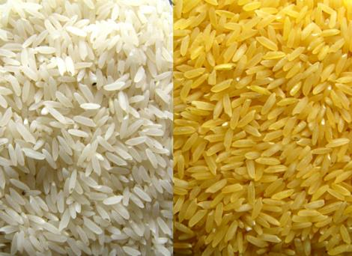
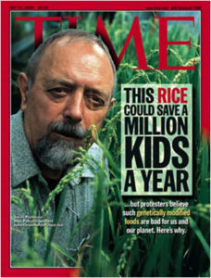
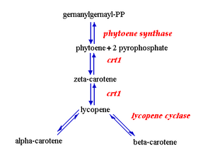
Golden Rice
Scientists have engineered in genes to turn ubiquitous precursors into pro-Vitamin A

Slide 10
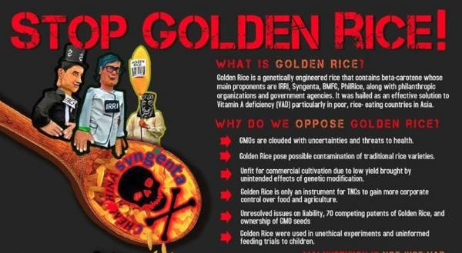
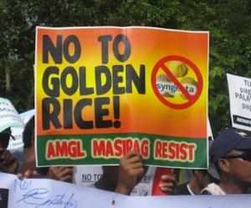
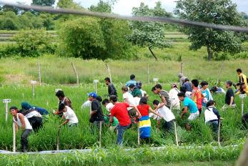
Opposition
Insufficient beta carotene to matter
“We don’t know long term effects”
“Tell them to eat carrots and leafy greens”
Opposition to golden rice cost $2 billion to farmers in developing countries and 1.4 million human years – Wesseler et al., 2014

Slide 11
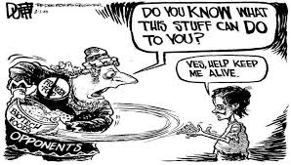
Currently
Approved in the Philippines in 2021
Growing in fields in 2023
A moratorium was recently passed to prohibit its sale.
Also to be grown in Bangladesh

Slide 12
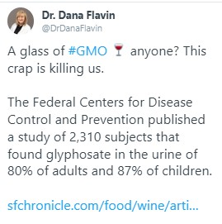



Glyphosate

Slide 13
We have unprecedented access to the best information in human history.
We have unprecedented access to the worst information in human history.
If we are going to manage the perception of agriculture and control the narrative, we must counter false information in the places where it is being propagated.

Slide 14
We need to control the narrative

Slide 15
Who is our audience?

Slide 16

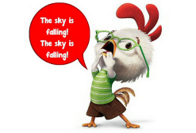


The Public is Unsure what to Believe
Pesticides
Antibiotics
Hormones
Fertilizer
Gluten
Synthetic Biology
Understanding makes me a better consumer.
Neonics
GMOs
Dihyrogen
monoxide
BPA
MSG
I don’t know what to believe, so I just won’t buy it.

Slide 17
Facts don’t matter.

Slide 18
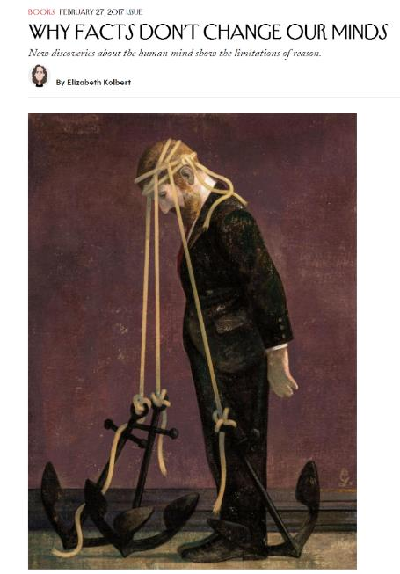
Facts do not matter
-- Until you establish trust.

Slide 19
A deficit of trust.

Slide 20
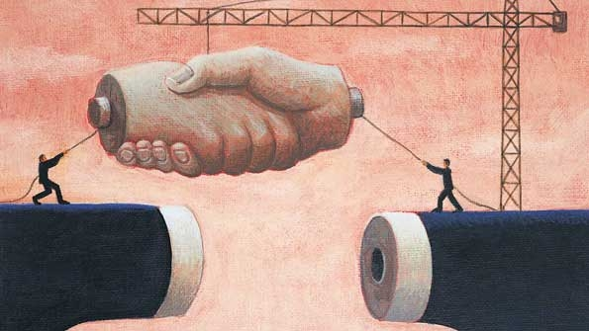
Trust Equation
Competence + Reliability + Intimacy
Self Motivation
TRUST =

Slide 21
Understand how information resonates

Slide 22

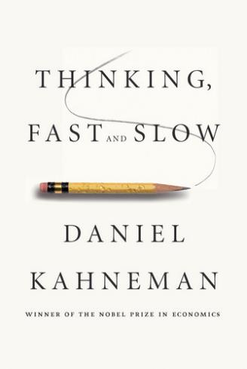
How we process information
System 1 – Emotional, irrational, reactive
Scientists, industry professionals, agricultural producers, etc.
Make some critical mistakes in engaging
System 2 – Logical, strategic, calculating
“I've learned that people will forget what you said, people will forget what you did, but people will never forget how you made them feel.”
- Maya Angelou

Slide 23
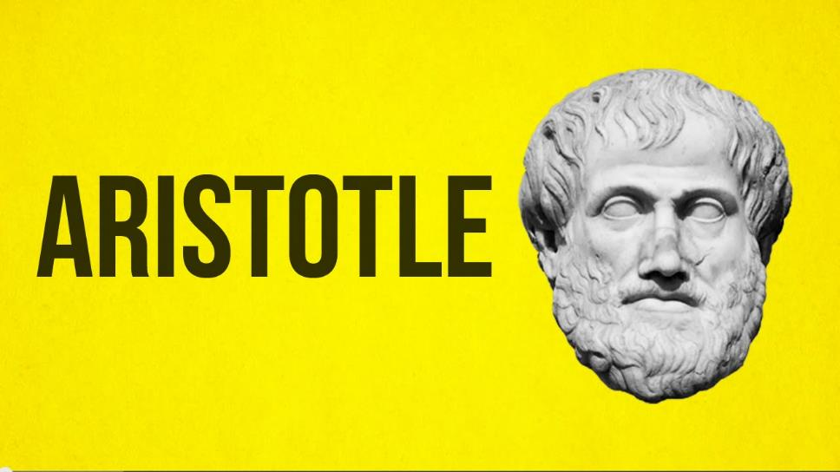
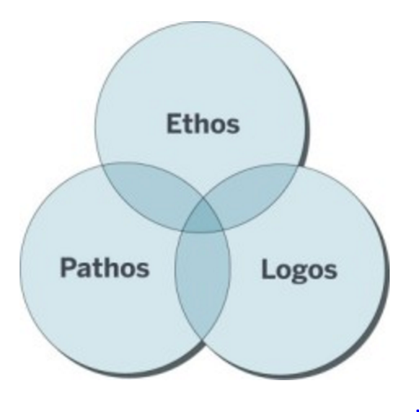
Lead With Your Ethics.

Slide 24
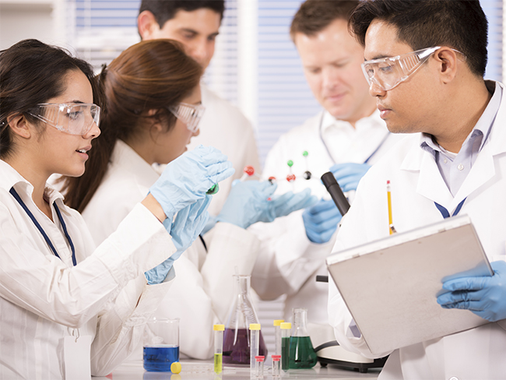
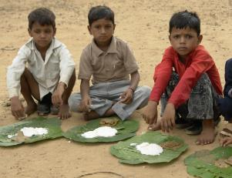

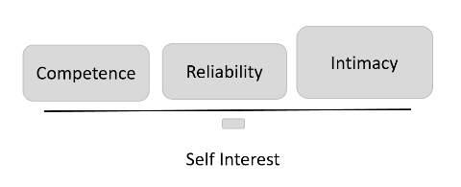
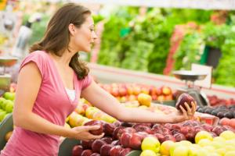
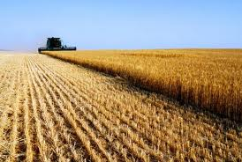
Building Trust with Shared Values
What are the issues that reflect your values?

Slide 25
Listen to Understand
Not to Debate

Slide 26
80/20 Rule

Slide 27
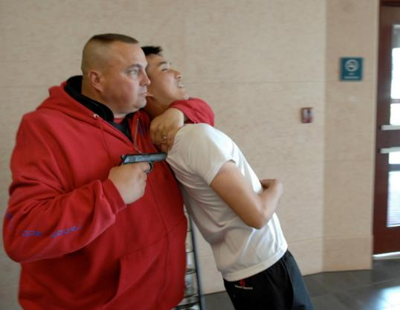

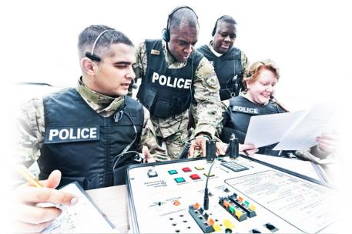
Active Listening
Intellectual Charity
Provide a sense of power and control in the conversation

Slide 28
Consider Intent

Slide 29
Confronting information on the internet requires understanding intent
Misinformation
Disinformation
Assume innocent intent of spreading false information; the speaker may be a victim of bad information

Slide 30
FAILURE 7
Relying on Your ‘What’ and ‘How’

Slide 31

“Golden Circle”- Simon Simek, Rand Corporation
People don’t buy what you do, they buy why you do it.
WHY
What
How

Slide 32
Exploit Networks,
Be Part of the Conversation

Slide 33


CONTENT
AMPLIFICATION
Write something and share with 1000 people
Share something you like with 1000 people

Slide 34
CONTENT
Video / YouTube
Blogs
Podcasts
Discussion boards
Reddit
Articles
News Article Comments Sections
Professionally societies

Slide 35

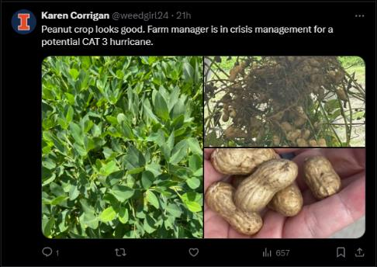
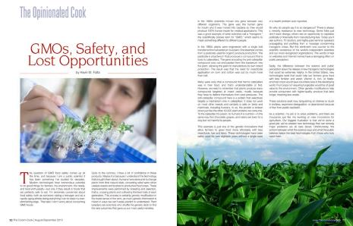
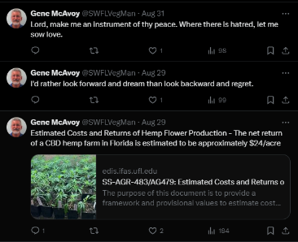

Slide 36
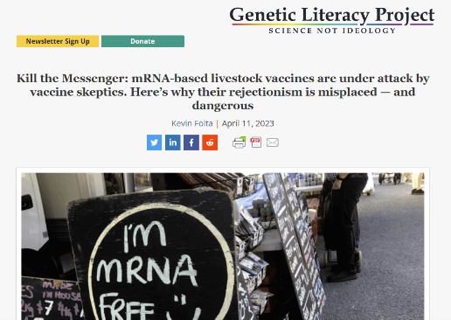

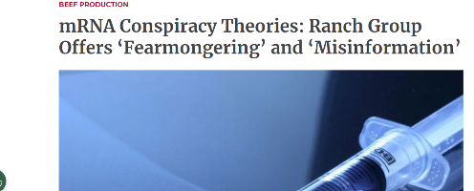
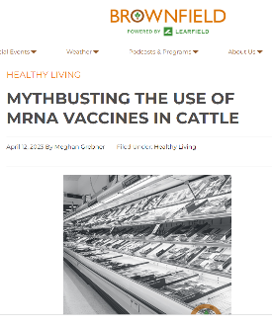

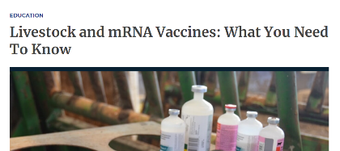
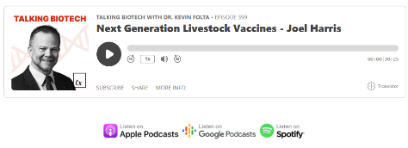
We Must Define the Narrative

Slide 37
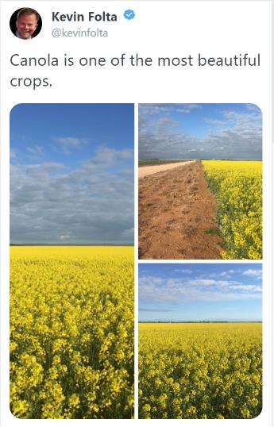
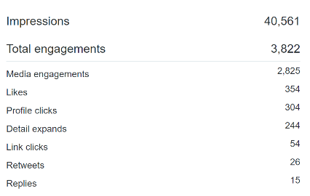
The Power of Amplification and Networks

Slide 38
AMPLIFICATION
Promote good information into your networks
Share media outside of your trusted communities
Share your “Why”

Slide 39
Why do we need to to this?

Slide 40
Listen
Earn trust
Share goals and values then talk about ag and science!
Devleop content
Share content

Slide 41
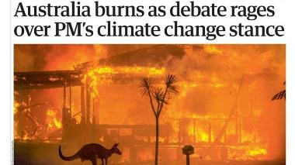

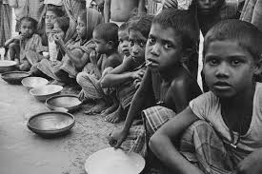


Innovation only moves to application with communication.

Slide 43


“Don’t tell me it can’t be done, tell me what needs to be done and help me do it. “ - Dr. Norman Borlaug
Thank you.
www.talkingbiotech.com
iTunes, Stitcher, Player FM
All funding, reimbursement:
www.kevinfolta.com/transparency
All slides:
www.slideshare.net/kevinfolta
kfolta@ufl.edu
kfolta.blogspot.com
@kevinfolta

