Slide 1

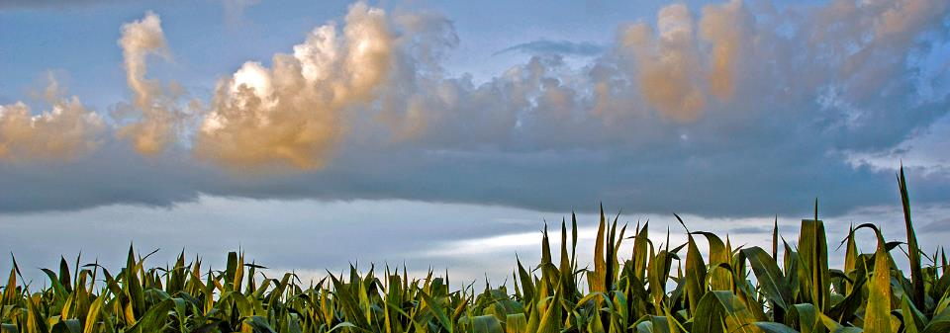
Enhancing Conservation Agronomists
A Model for Coordination, Training, and Support
Leif Fixen & Luke Petersen – TNC North America Agriculture
© NICK HALL

Slide 2
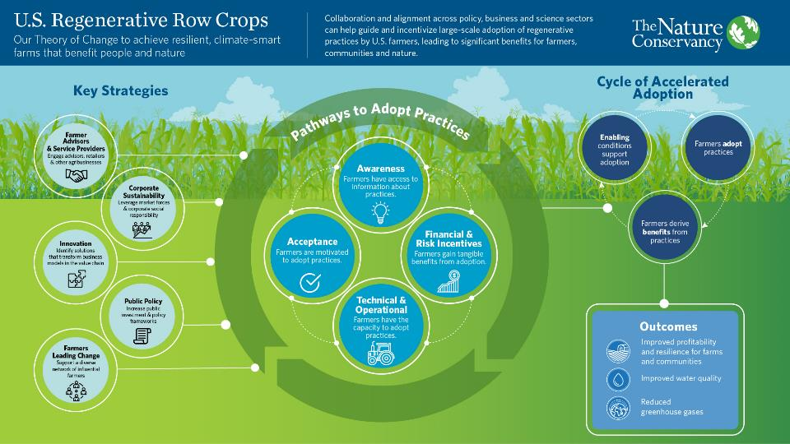

Slide 3
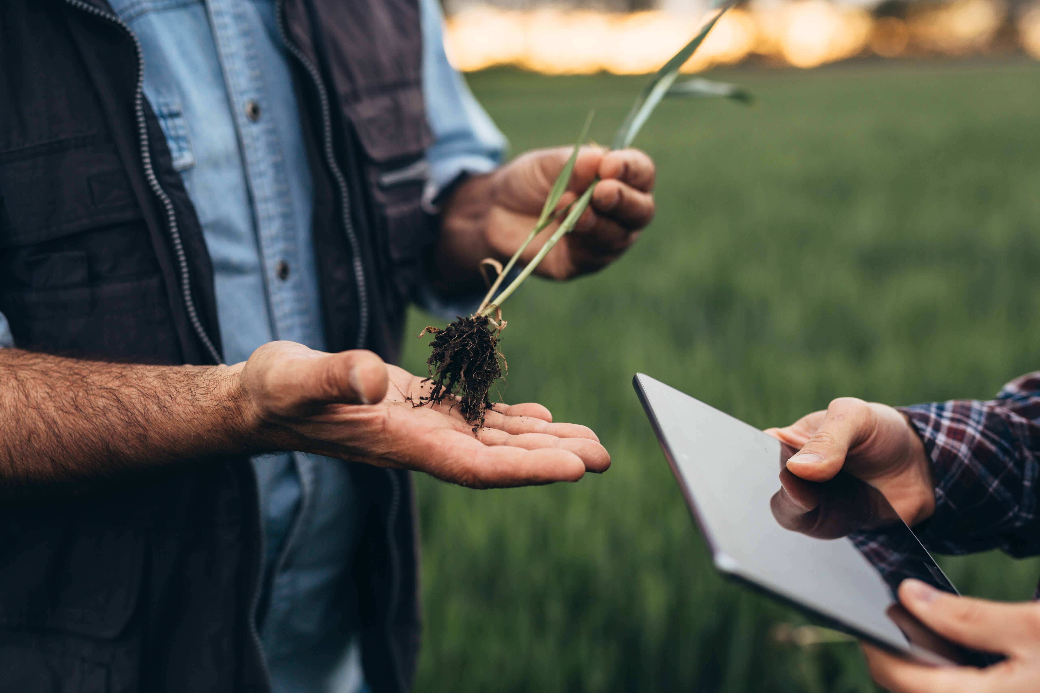
Why Farmer Advisors?
Retailers are highly trusted sources of agronomic information, but are not currently a major source of conservation assistance
(Purdue Large Commercial Producer Survey, CTIC Cover Crop Survey)
Wide reach: 12,357 CCAs and 385 CPAgs
  22% with 70+ grower clients
  28% service 40,000+ acres
There’s an increasing demand and investment in sustainability
If we want farmer adoption to happen at the pace & scale needed to address climate change and biodiversity issues, we need to incentivize advisors to change before they see a demand signal to change
Pace AND Scale:
Notes:
Demand from CPGs, consumers, farmers. Funding from government (BIL, IRA, state programs) and private.

Slide 4
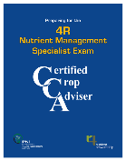

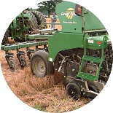
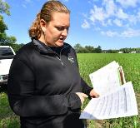




TNC’s Farmer Advisor Work to Date
Equipment
Cost Share
Conservation
Agronomists
Training & Education
Recognition
Market Research / Surveying
Risk Management
Business Model Research
Notes:
Equipment Cost share:
Up to 35% ($20,000) Cost Share
Minimum 1st Year commitment of 5 Farms & 500 Acres of New Cover Crops
Goal of 1,000 acres in 2022 & 2,000 acres in year 2023 for each participant
7 New pieces of equipment
4 new businesses
3,500+ New Acres impacted on 35 new farms in 2021 growing season
4 New Demo Programs
Multiple approaches piloted in focused area (All Acres for Our Water in MN)

Slide 5
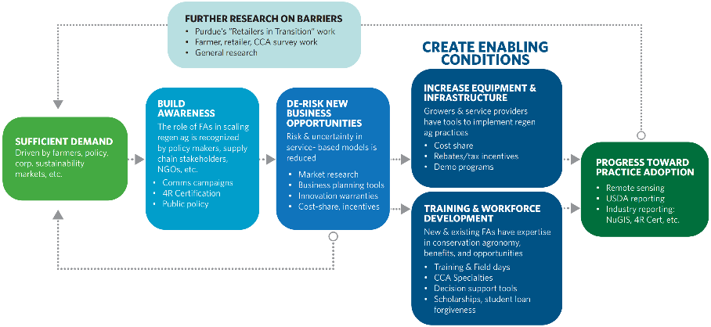
Farmer Advisor Theory of Change
Goals
1. Prove & build awareness of new business opportunities
2. De-risk businesses leading the demand curve
3. Create enabling conditions to accelerate adoption

Slide 6
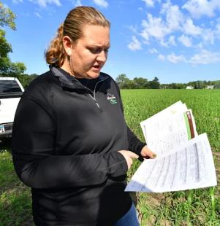
What is a conservation agronomist?
Provide TA related to:
  Conservation/soil health BMP integration & implementation
  Data insights
  Gov incentive program enrollment / reporting (USDA, State, local)
  Private incentive program enrollment / reporting (C markets, CPG supply chain projects, etc)
  Regulation / ESA programming integration
Typically housed within agribusinesses (coops, retailers, etc.)
May or may not be integrated into sales agronomy team
Often at least partially funded by NGO/public/external sources
Increasing interest and funding for these positions

Slide 7
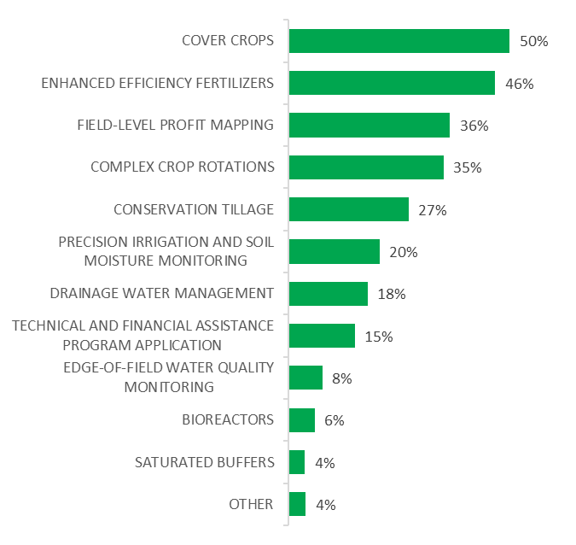
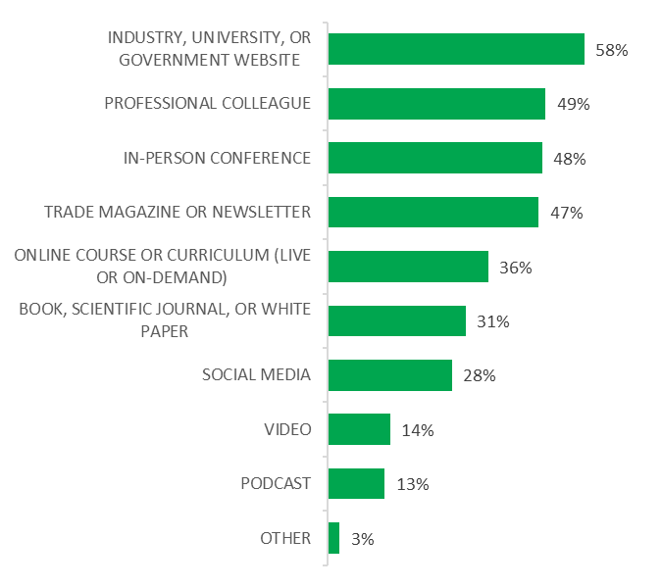
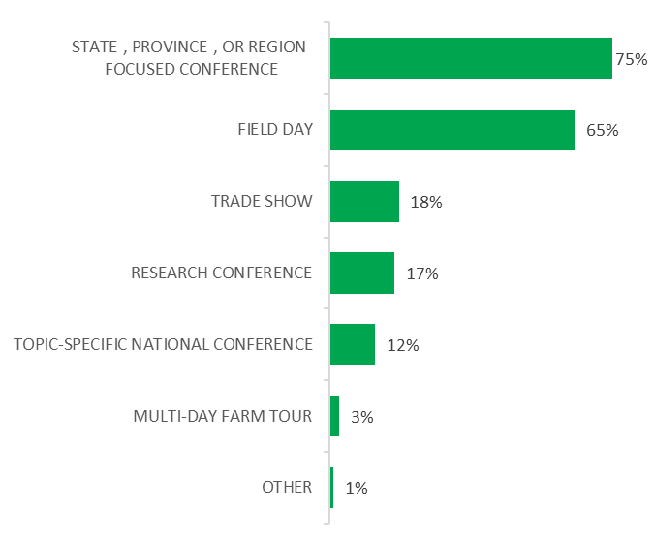
What do CCAs Want?
Preferred Topics
Information Source
Education Type

Slide 8

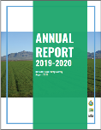
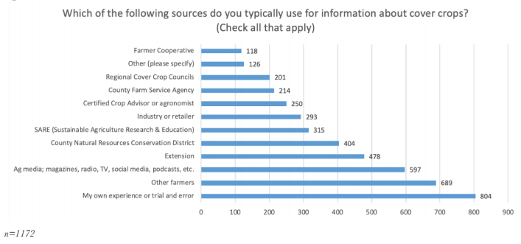
2019-2020 Cover Crop Survey
21%
https://www.ctic.org/data/Cover_Crops_Research_and_Demonstration_Cover_Crop_Survey
Notes:
4% of US farmers using

Slide 9
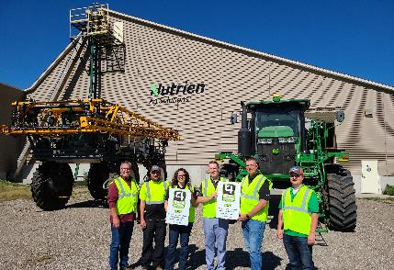
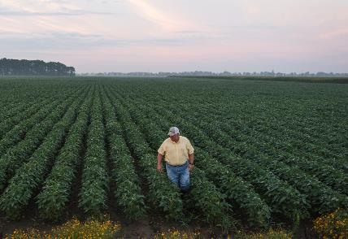
Research Design
5 Focus Groups with Retailers
Focus Groups with Farmers
Mirrored Questions
Notes:
we wanted to understand if there are gaps – the questions were mirrored.
5 Focus Groups with Retailers
How much adoption have you seen of each conservation practice?
What are the critical barriers to adoption for growers?
What do conservation practices mean to you in terms of business opportunities (positive, negative, or neutral and why)?
Do you have any stream of revenue coming from conservation practices (if yes, please explain)?
What are the challenges to implementing fee-based sustainability services
Focus Groups with Farmers
Do you adopt any conservation practices?
What are the most important benefits/reasons to adopt conservation practices?
What are the critical barriers to adopting conservation practices?
Are you planning to adopt conservation practices more extensively in the future?
When adopting conservation practices, what are your most relevant expenses or investments? To whom do you normally pay these expenses?
Who are your partners in adopting conservation practices? In your opinion, what role do ag retailers play in assisting with conservation practice adoption (now and in the future)?

Slide 10
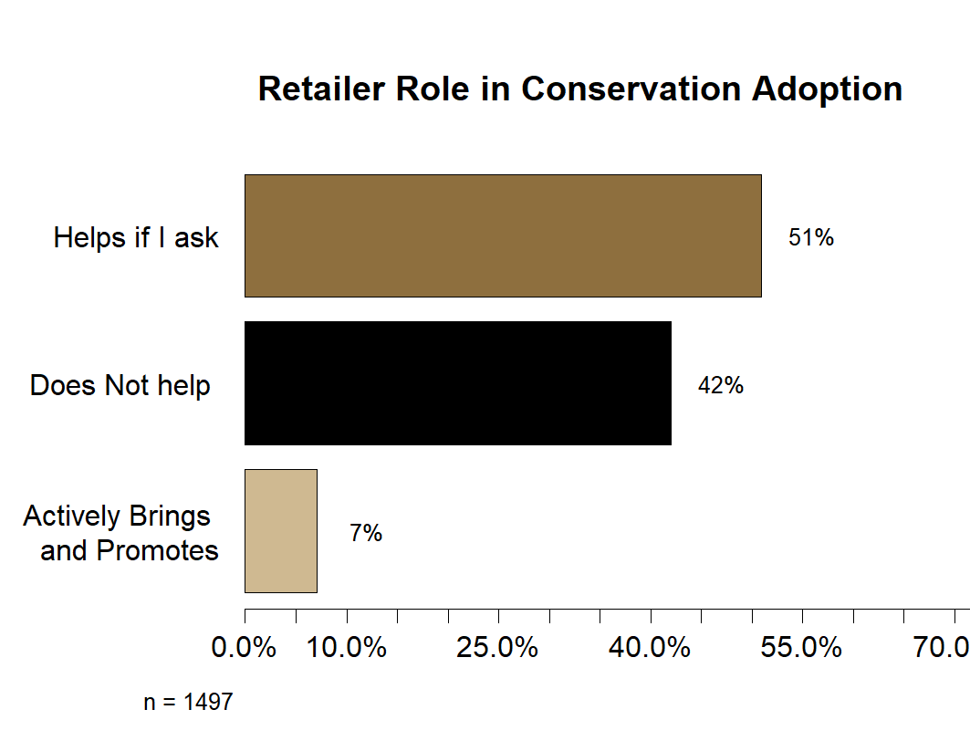
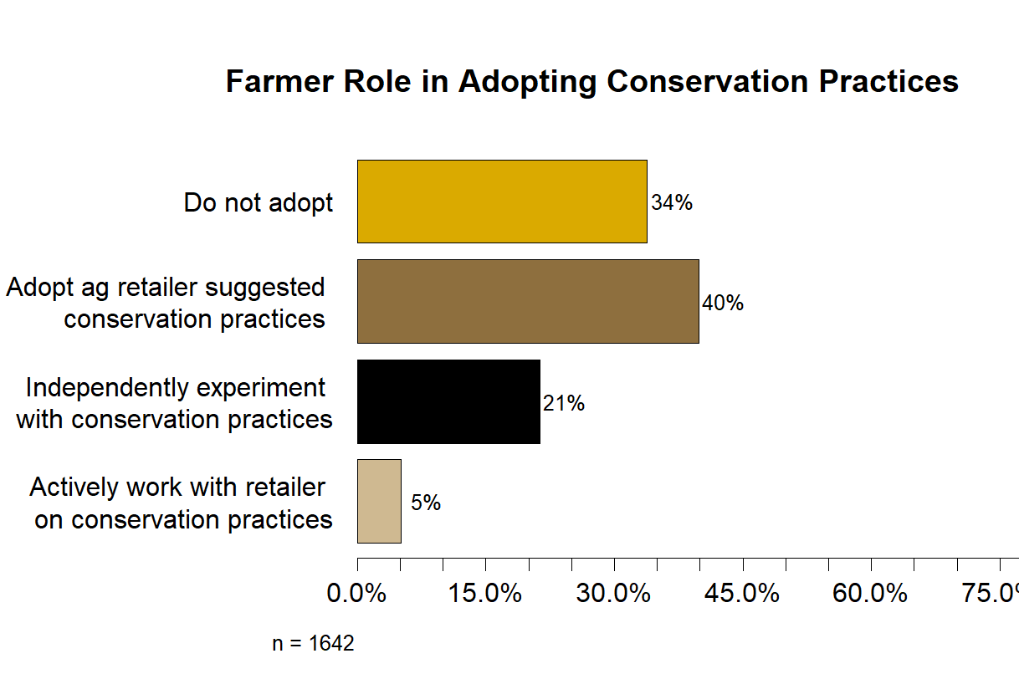
Notes:
Q37: With regards to the role your ag retailer/dealer plays in adopting conservation practices, please select the statement below that best describes their role in this process.
□ My retailer does not help me adopt conservation practices
□ My retailer will help me adopt conservation practices if I ask for services related to that practice
□ My retailer actively brings and promotes new conservation practices to me to adopt
Q38: With regards to your role as a farmer in adopting conservation practices, please select the statement below that best describes your approach in adopting conservation practices.
□ I do not adopt conservation practices
□ I adopt conservation practices that my ag retailer suggests to me or I have seen other farmers in my region implementing to know that they work
□ I actively experiment with conservation practices to find out what works for my farm with help from my ag retailer or other farmers in the area
□ I actively experiment with conservation practices to find out what works for my farm and do the entire process myself with no help from my ag retailer or other area farmers

Slide 11
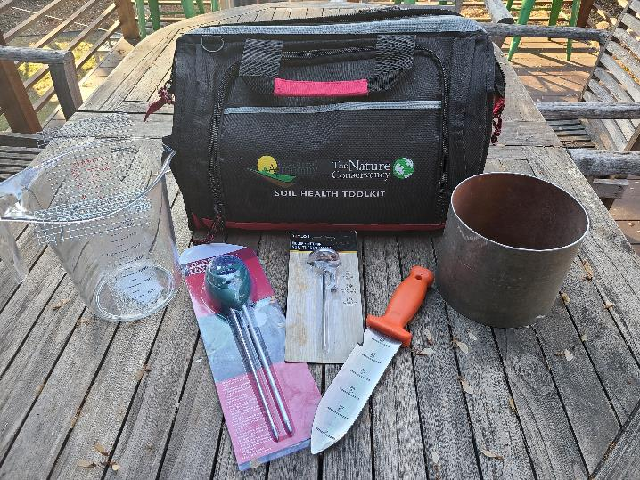

Slide 13





Program Examples
Trusted Advisor Program (TAP): ND, Canada, IL
IA Ag Water Alliance / IA Soybean Asc.– Conservation Agronomist Network (13 CAs)
ISAP Program (65 applicants for 25 seats, 5th yr?)
  https://ilsustainableag.org/programs/soil-health/shlp/
Advanced Soil Health International Certificate Training Course,
  https://blogs.cornell.edu/soilhealth-training/
Truterra Conservation Agronomists Program (27 CAs @ 20 Coops)
TNC’s Enrollment Specialist program

Slide 14
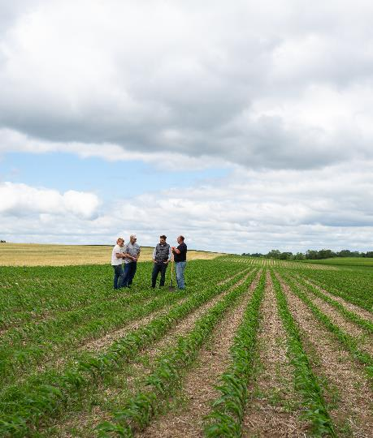
The Challenge
Various CA models are being tested – how do we effectively scale/replicate successful approaches to drive value to the business and farmer costumers
Currently, no standardized trainings, certifications, or resources exist
Limited technical support or peer interaction opportunities for CAs
Need to increase # of CAs and support to more states
The Opportunity
ICCA could be the pre-competitive support mechanism for CAs across companies, states and regions
ICCA already has infrastructure and goe footprint
Already have standardized certifications, trainings and resources to build from
Drive new value to the CCA program
Has a connection to latest research via ASA
Notes:
Additional challenge: declining interest in CCA certification
Must drive value to be sustainable

Slide 15
Conservation Agronomist / Sustainability Specialty Program
CCA Required
???
Training & Tools Library
Peer to Peer Networking & Support
Certification / Specialty
National trainings
Provide locally relevant trainings based on frequently asked questions, needs, current events
Review and inventory tools and resources (CTIC’s Conservation Connector) local & national
Offer “sponsored training
Peer to peer networking
Peer to peer trouble shooting
List serve / Social media engagement
Pre-competitive source of help
Hosting social events
Validate Knowledge
Provide a roadmap for developing skills & expertise
Create consistency across geographies
A pathway for farmers and supply chain partners to find farmer facing experts
NRCS TSP Certification
Offer a streamlined pathway for CCAs to gain a TSP certification

Slide 16
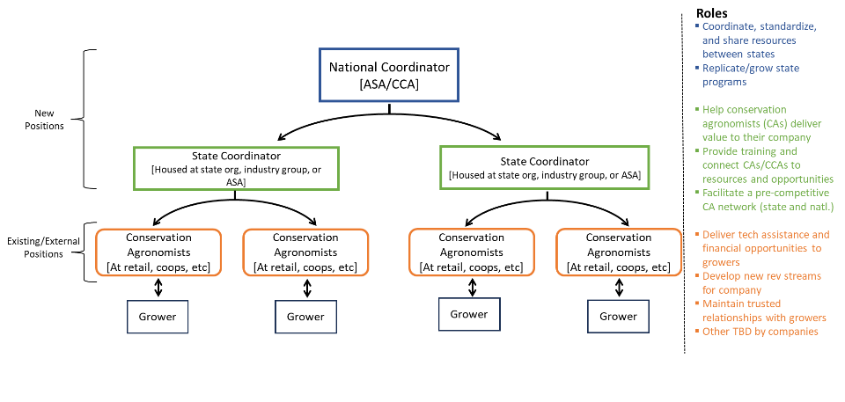
Notes:
The model:
A cohort of State Coordinators hosted by state ag organizations, industry groups, or ASA/ the national CCA program, each serving as a resource and connector for individual CAs by facilitating trainings and a peer learning network, maintaining a knowledgebase of grower opportunities, and helping businesses achieve value in their CA positions.
A National Coordinator employed and hosted by the ASA/CCA program, who would standardize training materials and resources across states, maintain a multi-state CA network, and seek opportunities to expand the State Coordinator positions into new geographies.

Slide 17
Budget
Funding Sources
$3.4M for 3 yr, 7 state pilot
  (this will be much less as we can leverage existing programs)
  $160k/yr National Coordinator
  $140k/yr Per State Coordinator
States with programs already funded: ND, IA, MN, IL, Prairie Providences, Truterra
Additional Target States: Chesapeake, Ontario, MI?
Federal / NRCS – Add requests to state level proposals for a State Coordinator
State gov funding
Corporate sponsorship
Industry association funded
Philanthropic foundations
Enrollment fee structure
Conservation Agronomist Program | Per Yr | 3yr pilot (7 states)
National Director (salary & ben) | $ 130,000 | $ 390,000
Supplies & Program Expenses | $ 15,000 | $ 45,000
Marketing & Outreach | $ 10,000 | $ 30,000
National Program Total | $ 155,000 | $ 465,000
State Coord (salary & ben) | $ 120,000 | $2,520,000
Supplies & Program Expenses | $ 20,000 | $ 420,000
State Program Total (per state) | $ 140,000 | $2,940,000
 | 3yr program | $3,405,000

Slide 18
Discussion Questions
Is ICCA interested in expanding into this leadership role?
If so:
Are you interested in partnering with TNC on this effort?
What’s the best way to move forward with co-creation?
How soon are you comfortable co-fundraising?
  How comfortable are you with TNC using claiming ICCA as a partner?
Who else should be involved?

Slide 19
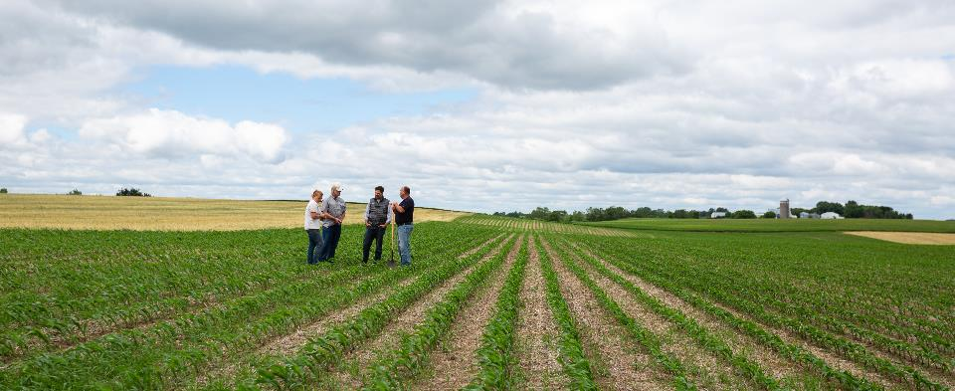

Leif Fixen
Leif.fixen@tnc.org

Slide 20
Policy Ideas (updated: 9/25/2024)
Streamlining the TSP process – there’s already work happening here, but it’d be good if we could figure out how to keep it moving. I’m fearful it’s getting stalled with the Farm Bill, and we need to keep building our TA capacity.
  USDA needs better tools for doing TSP and planning work that better utilize technology to help simplify and speed up the planning process
  USDA needs a more standardized format for certain practice standards (I can’t believe I just said that) – specifically a format for 590 – this could also help guide TSPs and NRCS planners through the planning process – functioning as a guide.
FA Incentive Programming: Ways for USDA to directly incentivize farmer advisors to recruit and help their farmers through gov. programs. Our ESMC pilot in MN is an example of this – NRCS is funding the “enrollment specialist” program that we developed that pays $3/acre to help farmers learn about and enroll in our pilot. I’d like to see this expanded to other USDA programs. Right now (for the most part) the funds go to the farmer, who can then chose to hire an advisor to help – provided they’re a TSP (for the most part). This creates a little bit of tension about how much the farmer passes through. By separately incentivizing both the farmer and the advisor independently, we simplify, and speed up the process, and motivate both parties to be on board.
Long term Funding: Figure out longer term funding for “Conservation Agronomists” (CA). I was at a conference in IA this week focused on conservation agronomy (Sec. Bonnie spoke at it), and the issue of funding permanence was brought up several times over the 2 days– what do we do if the fed. funding dries up? By finding ways to make the farmer advisor / CA role more permanently funded, I think we’ll see more permanent investment in the work from agribusiness.
  This is also where our “retailer of the future” work comes in, and our work to better define new business models for retailers.
Simplify Programming: We have to figure out how to simplify USDA programs. Way to much red tape and rigidity to practice standards. (an oldie, but goodie)
Equipment Cost share: USDA needs to get comfortable / OK with directly cost sharing on equipment for both farmers and agribusinesses. I’d like to do some research to see if this approach leads to better permanence of practice adoption – ie. if we get farmers and retailers to invest in infrastructure and assets vs. just paying per/acre practice, I think we make it harder revert back to the previous practice.
Workforce development: I’d like to launch a student loan forgiveness program for “conservation agronomists” – this could have a BIPOC advisor component to it, see attached email.
Conservation Connector Support: NRCS commits to posting all of their incentive programs on the “conservation connector” that we’re building with CTIC to make it easier for farmers, and advisors to learn about incentive programs, regen ag services available for their specific farm (“Facebook Marketplace for conservation programs). It would be a big help if NRCS would commit a staff person in each state to keep the website updated with available fed programs
  A PCSC project is funding the bulk of building this, with TNC putting up $90k in match.

Slide 21
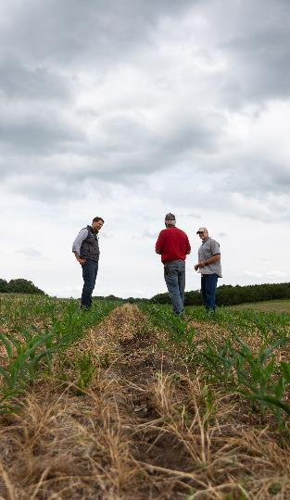
Who is a “Farmer Advisor”?
People, businesses, organizations that provide advise, products, and services to farmers and ranchers
Agronomist
CCA
Professional Agrologist
Sales Agronomist
Ag lender
Animal Nutritionists
Crop input manufactures
Extension Educators
Equipment dealers
Farmer / Commodity group staff
NRCS staff
SWCD Planners
Farm Manager (NOLO)

Slide 22
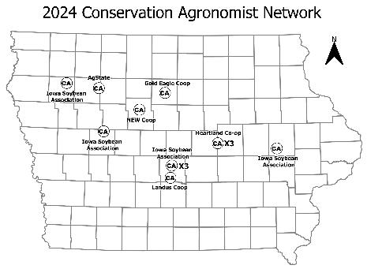
Expand Technical & Financial Assistance
13 Conservation Agronomists
Mix of Iowa Soybean Association and hybrid work models with Ag Retail with dedicated cost share assistance
Building a network with back- office support
Providing conservation planning, agronomic and practice design work
Aligning with public and private programs
Engage farmers to implement conservation

Slide 23
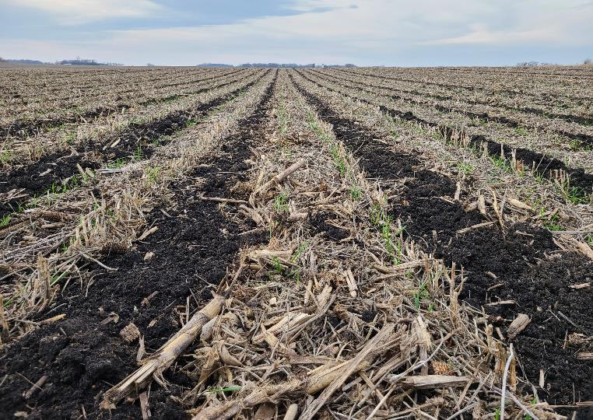
Strategic Goals
Prove & build awareness of new business opportunities
De-risk leading the demand curve
Create enabling conditions for accelerating adoption

